Slide 1









With thanks to our sponsors

Slide 2



Tai Orooro Tai Auaha
THROUGH WĀNANGA
Tai Orooro Tai AUAHA
2025
Notes:
Ko te mihi tuatahi ki te atua, ko ia te timata me te whakamutunga i nga mea katoa
Ka whakaarohia, ka mihia te hunga kua wheturangitia. Ahu atu koutou i te kupenga nui a Taramainuku ki a Pohutukawa, okioki mai ra.
Āpiti hono, tātai hono, rātau te hunga mate ki a rātau, apiti hono, tātai hono, ko tātau te hunga ora, ki a tātau.
Me mihi ka tika ki te Mana Whenua ki Te Atiawa, ko Ngati Tara - e pupuri tonu nei I te mauri o te whenua. Kei te mihi Kei te mihi. Ki nga maunga me mga wai horapa nei I tenei rohe ataahua o koutou.
He whakamoemiti atu nāku ki ngā iwi o MENZA. E koutou mā, e kore e taea e au te whakamārama te nui o taku whakamoemiti atu ki a koutou.
E te whare nei - kia whakaruruhau, kia hamaru to tatou kaupapa o MENZA - kia pupuritia kia uhia mātou I roto I to korowai o rangimarie me te aroha - Huro!

Slide 3
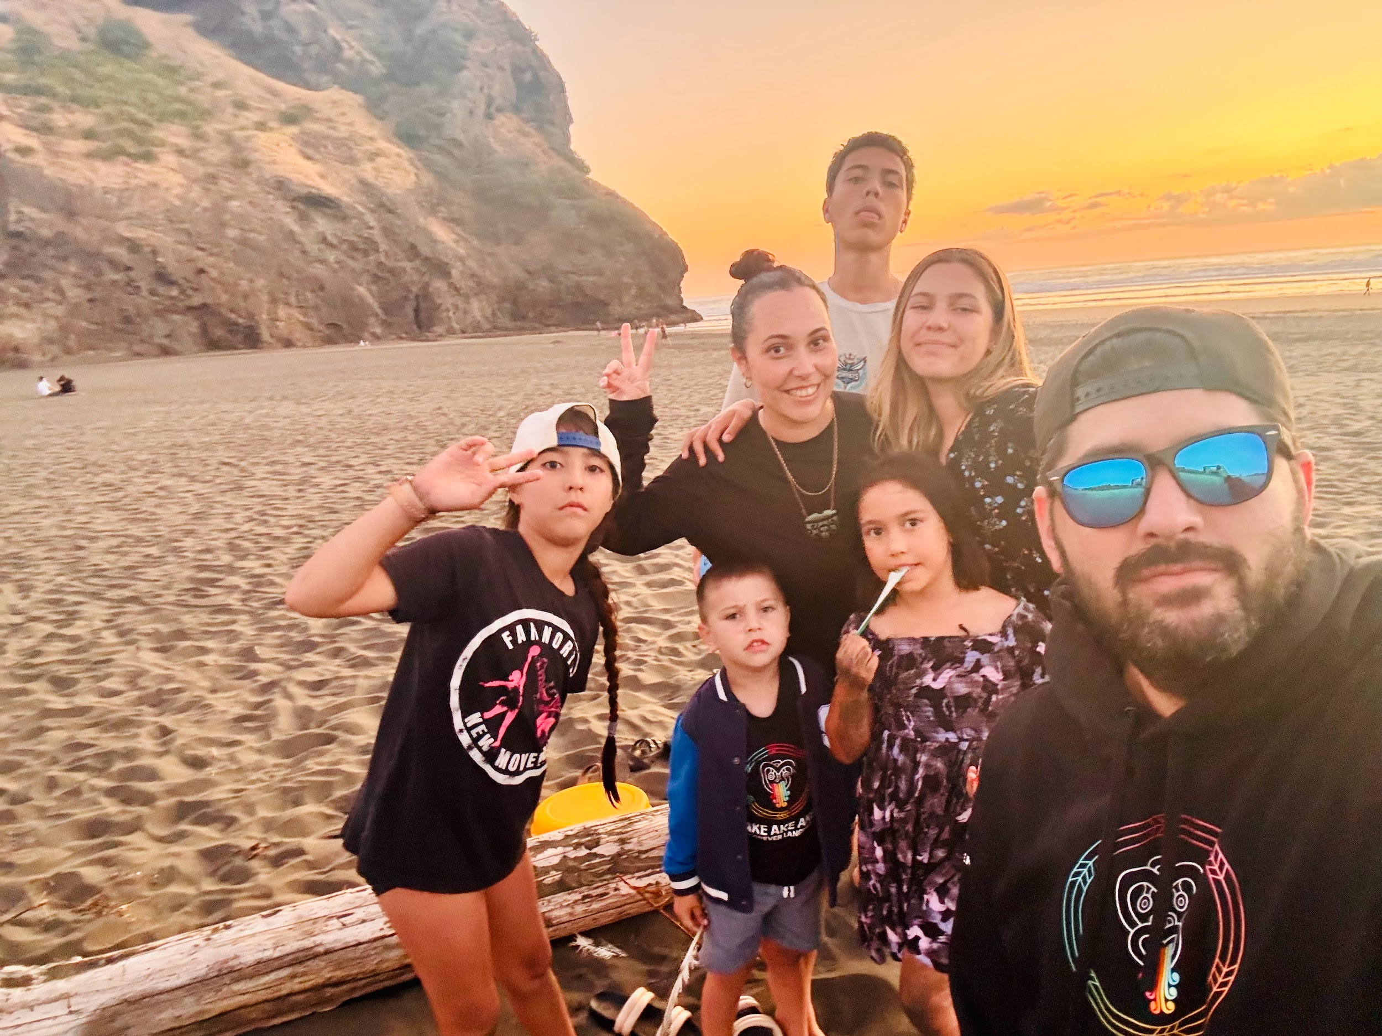

Slide 4
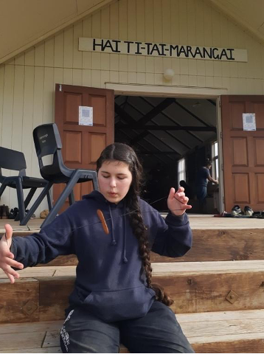
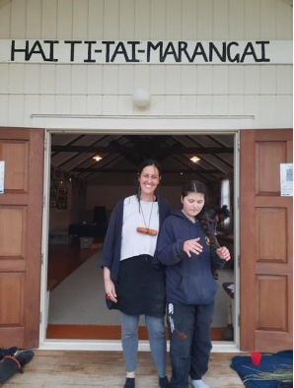
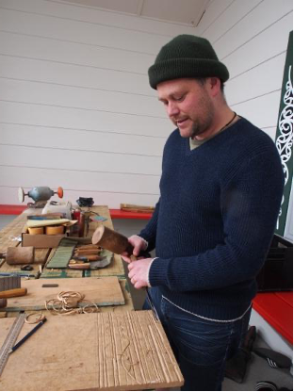
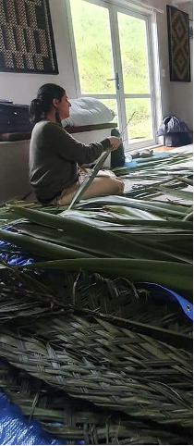
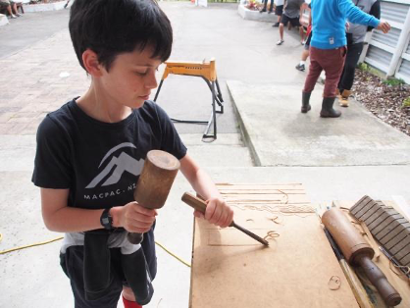
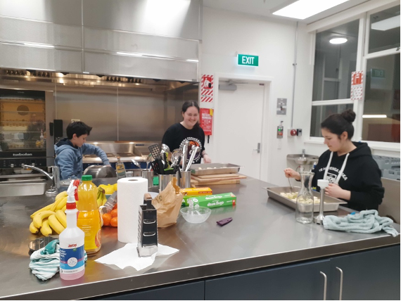

Slide 5
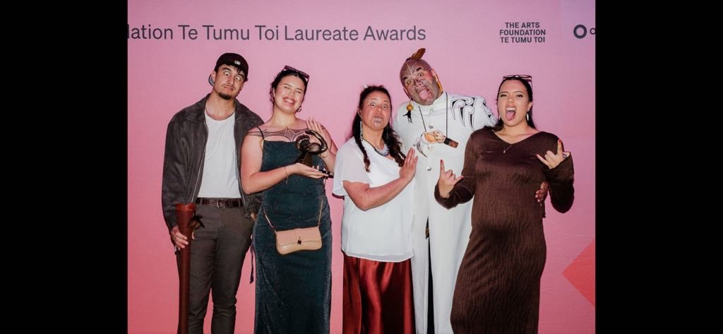

Slide 6
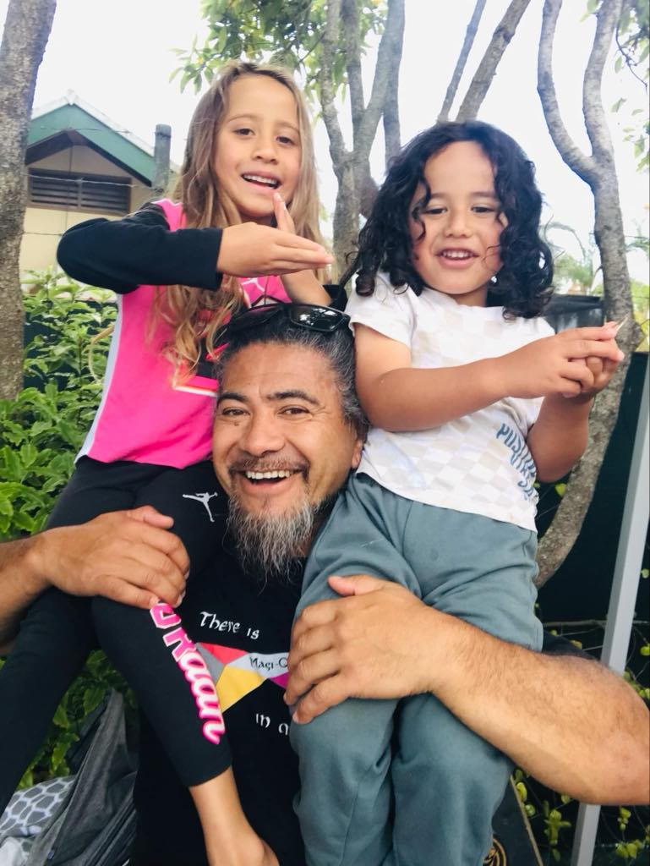

Slide 7
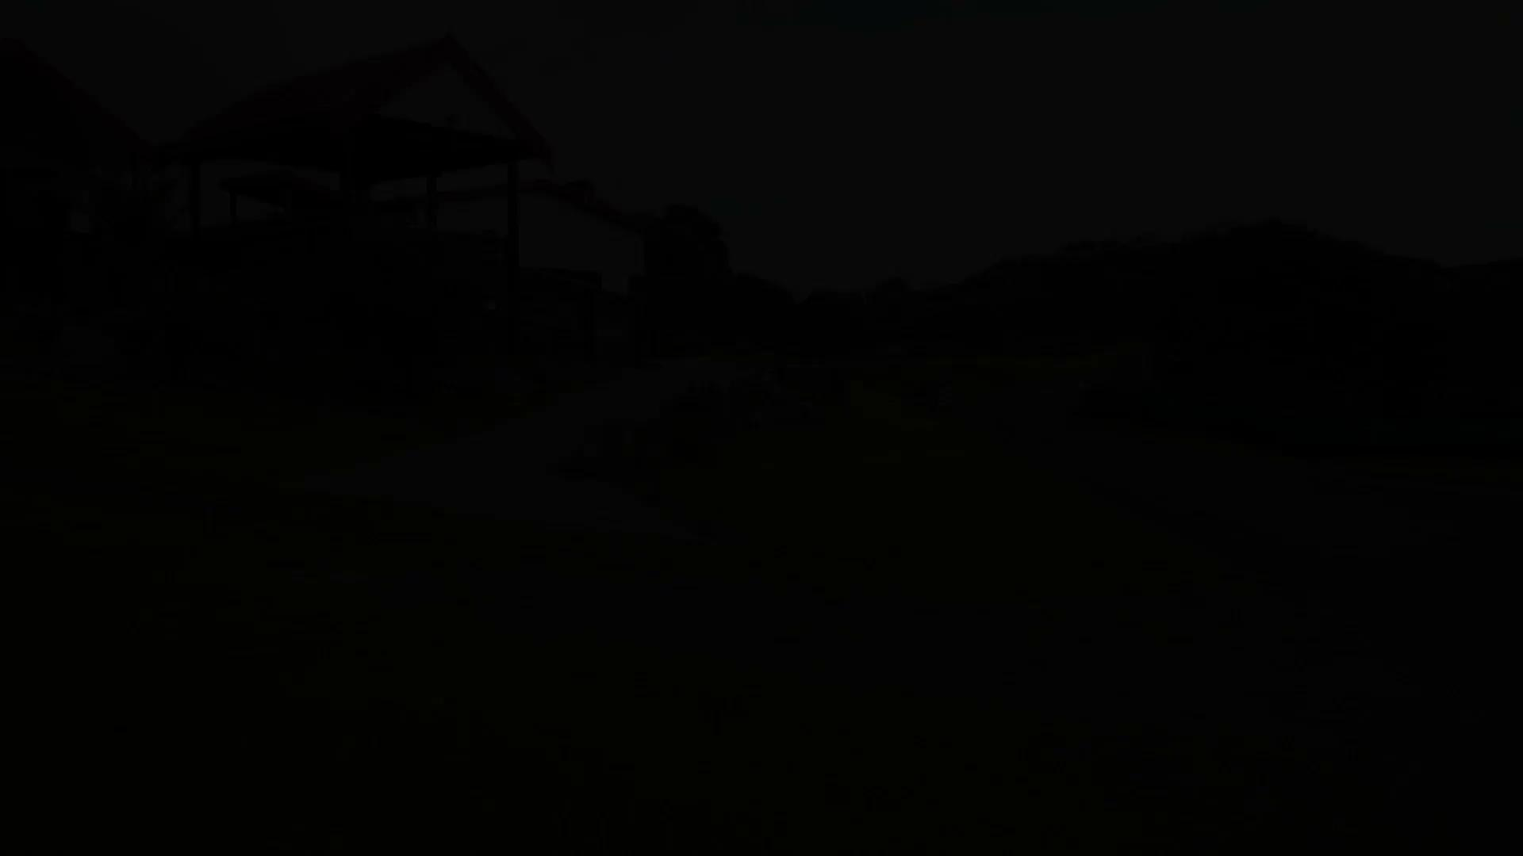

Wiremu Sarich

Slide 8

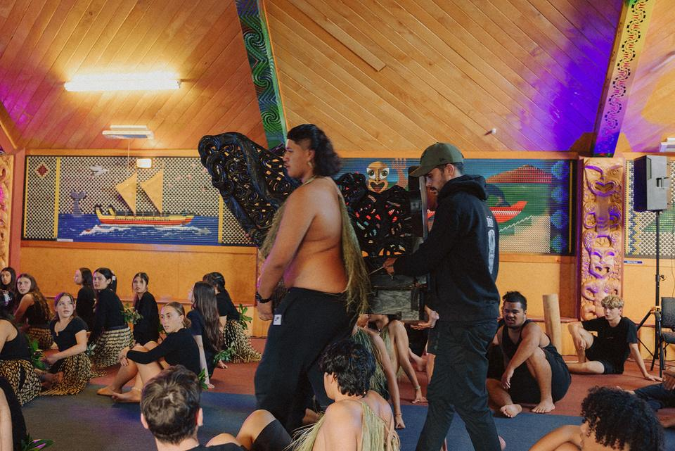
KAUPAPA
TAHI
Tikanga
TORU
Wānanga
Vision for change - The why, who, what, where and how.
The Marae is different from the School.
Students are different on the Marae.
Time
Place
People
RUA
Whānau
WHA
Whakawhiti kōrero
Avenger Squad
Having the right people in the right place.
There are some people who are movers and shakers.
Time to share kōrero, evaluate, reflect together
Mahia te mahi,
Hei painga mo te Iwi.

Slide 9


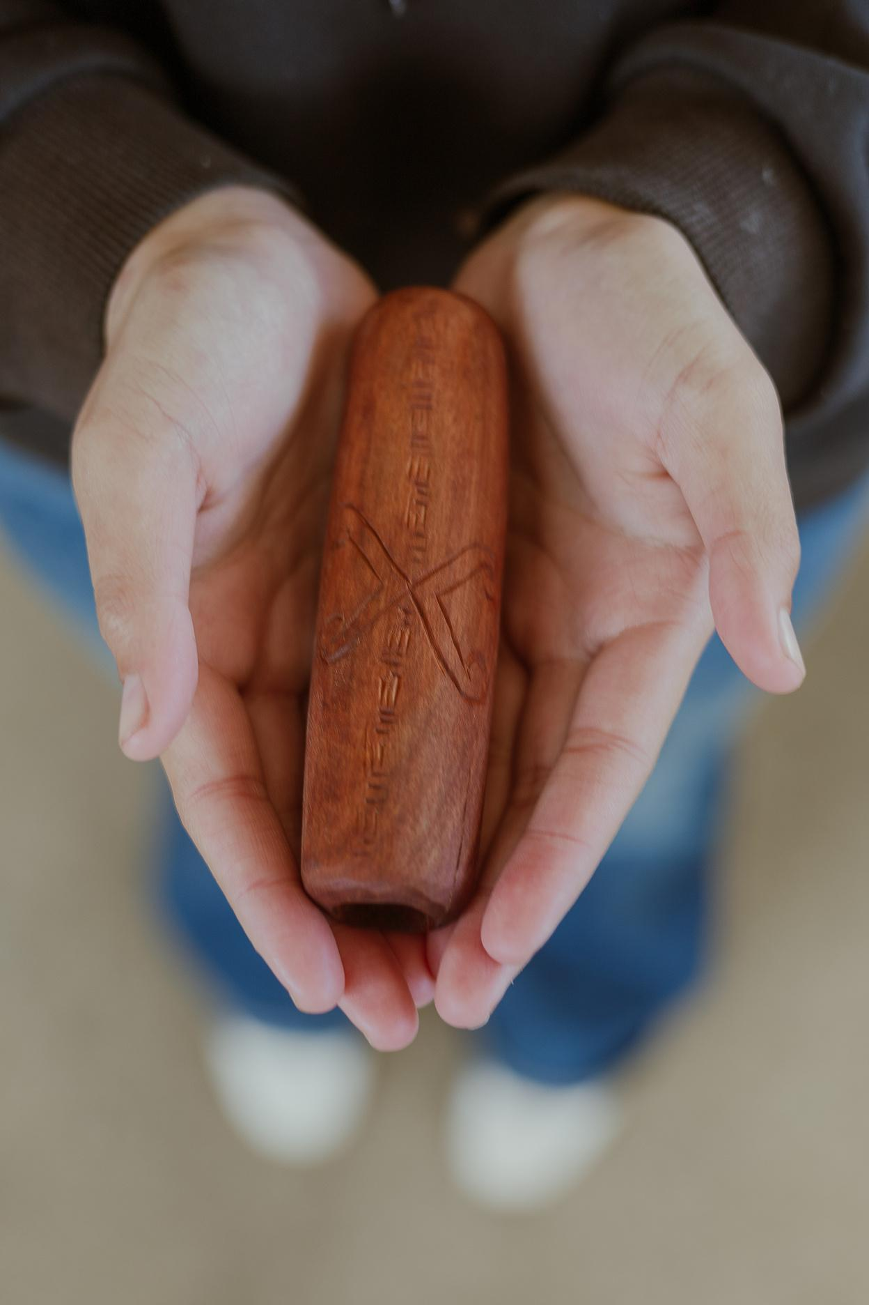
Rārangi Wā
2018: Moved home (Ngati Kahu)
2019: First Wananga Maitai Bay - James Webster, Darrin Pivac, Wiremu Sarich, Kylie Simeon
2020: 3 Wananga amongst Covid
2021: 3x 3 day wananga and 3 W/E Wananga
2022: 3x 5 day Wananga
2023: 3x 5 day Wananga
2024: 3x 5 day Wananga and
2024: 3 weeks at FestPAC 29 students
2025: Waitangi & Handover
Notes:
50 NCEA students attended wananga alongside others
They Gained:
1766 credits were achieved
177 at Merit
406 at Excellence
These we in Music, Dance, Te Ao Haka, Whakairo, Raranga, Tikanga Practices, Manaaki Marae, Physical Education and Trades.
These didn’t include credits for a MURAL created in the Whare Kai of Kenana Marae with Regan Balzer,
Hospitality & Marae Catering credits over the 15days on the Marae, and the Histories (Literacy) credits.
Consistent Planning & Evaluation
Proper Planning Prevents Piss Poor Performance

Slide 10

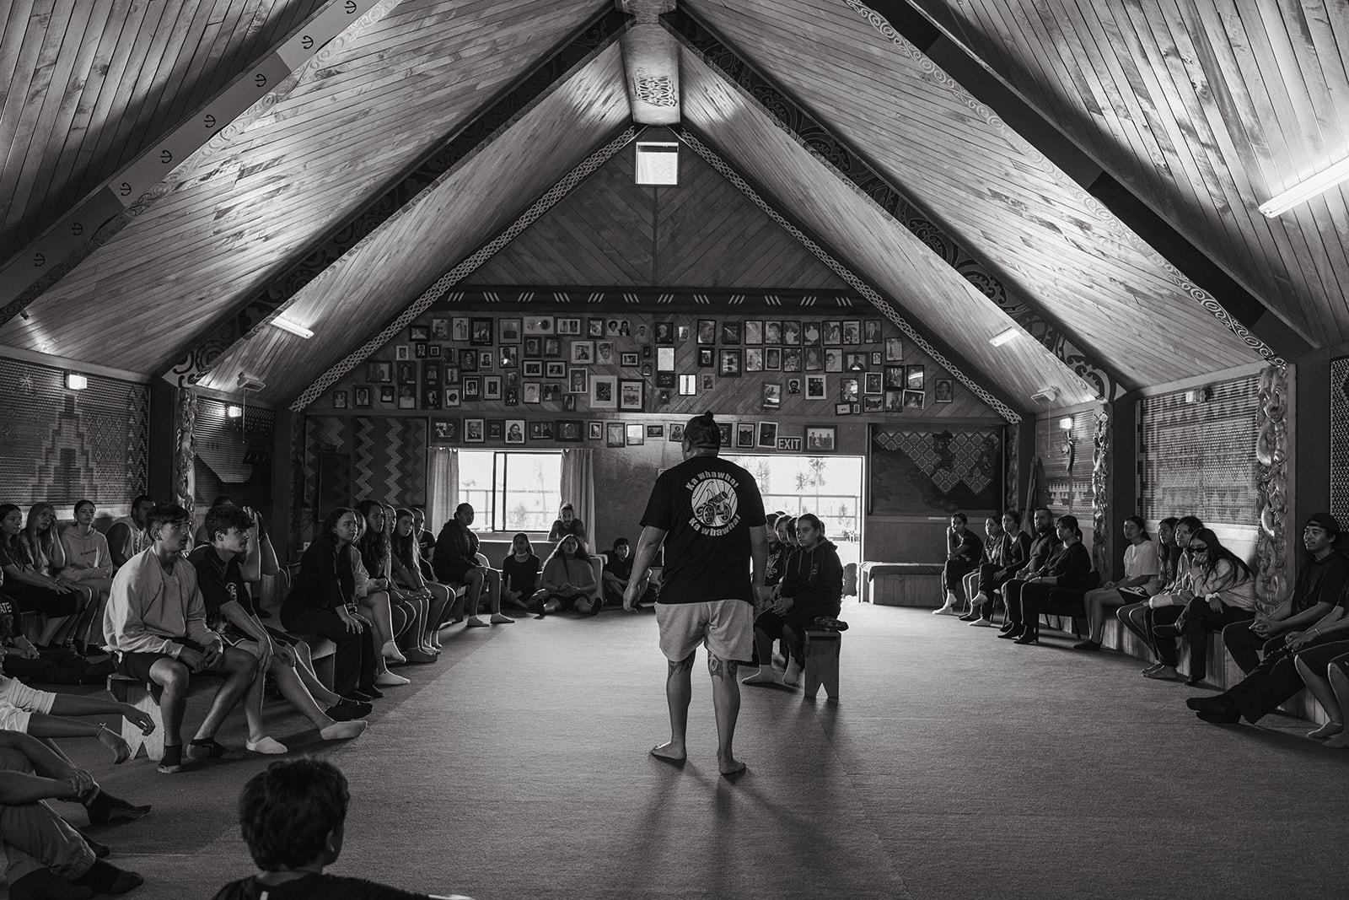
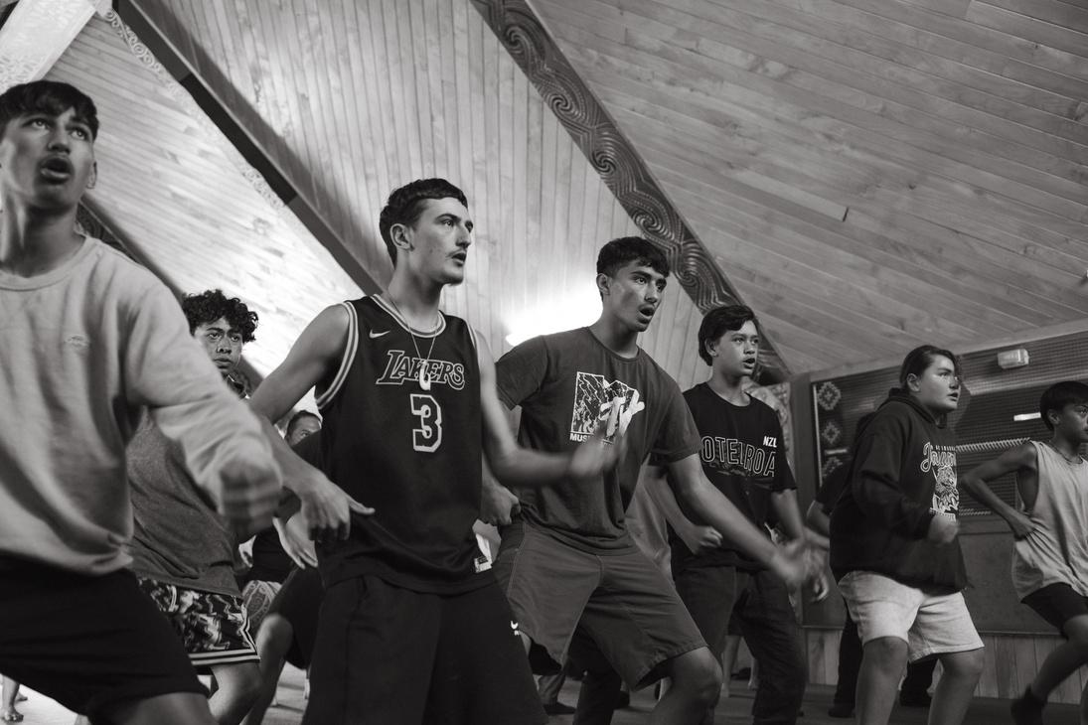

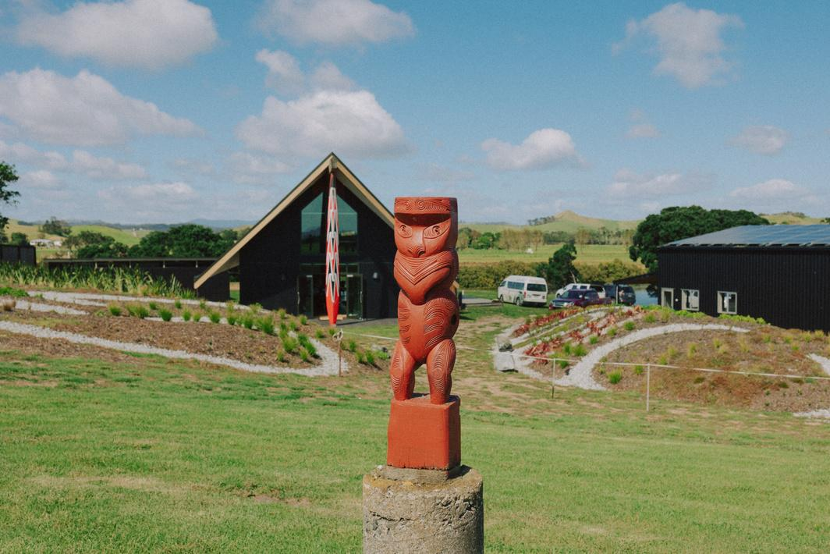

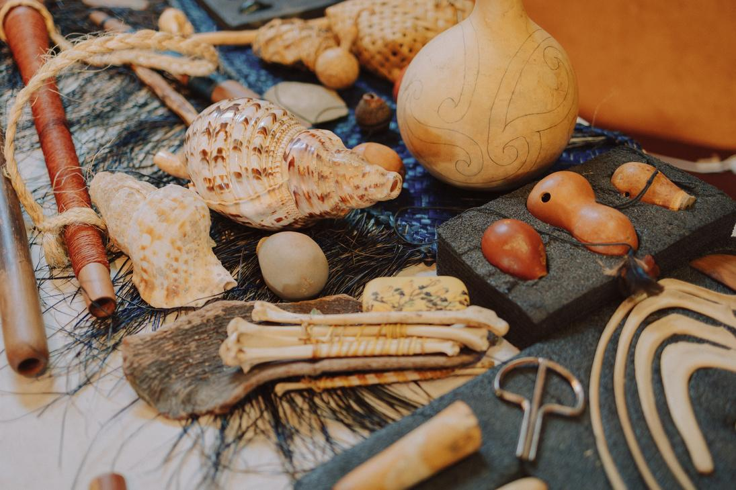

Tangata
Our greatest resource is our people.
Pūrākau
Our greatest knowledge is our stories
Pūoro
Our greatest healer is our vibration
E kore te patiki e hoki ki tona puehu
The flounder (fish) does not return to his dust
Do not make the same mistake twice.
Take every opportunity, as it may not come around again.

Slide 11
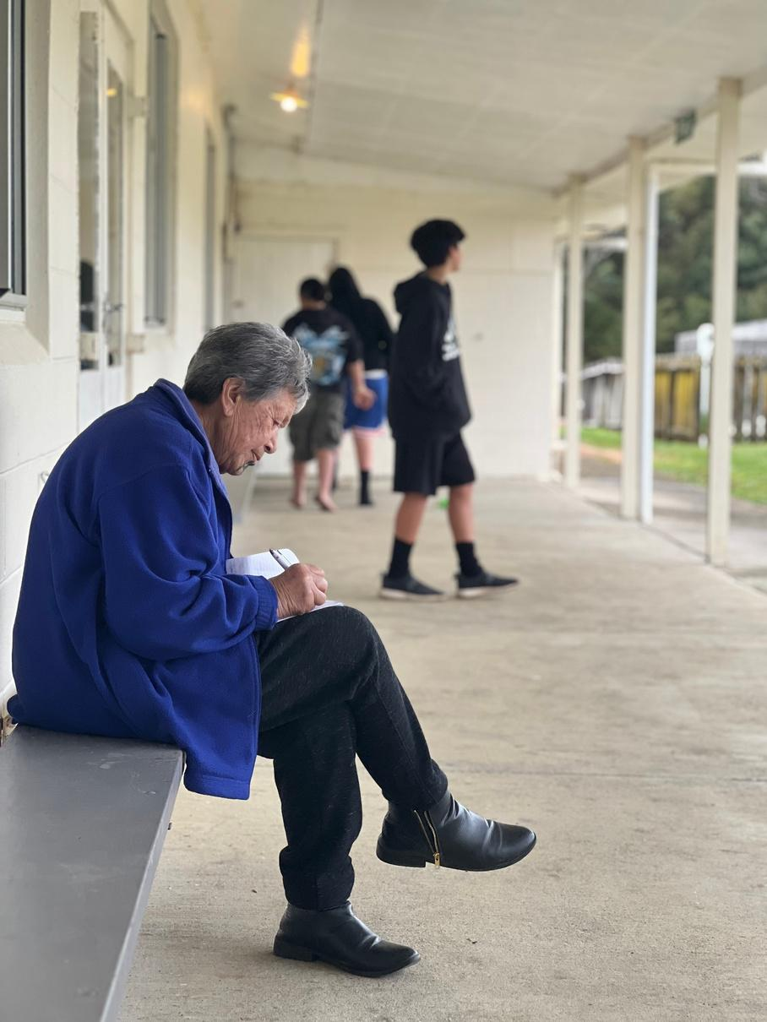
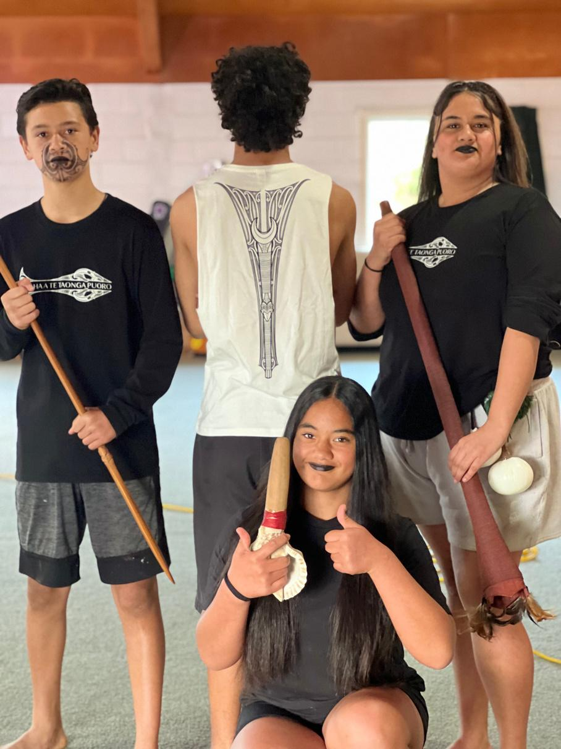
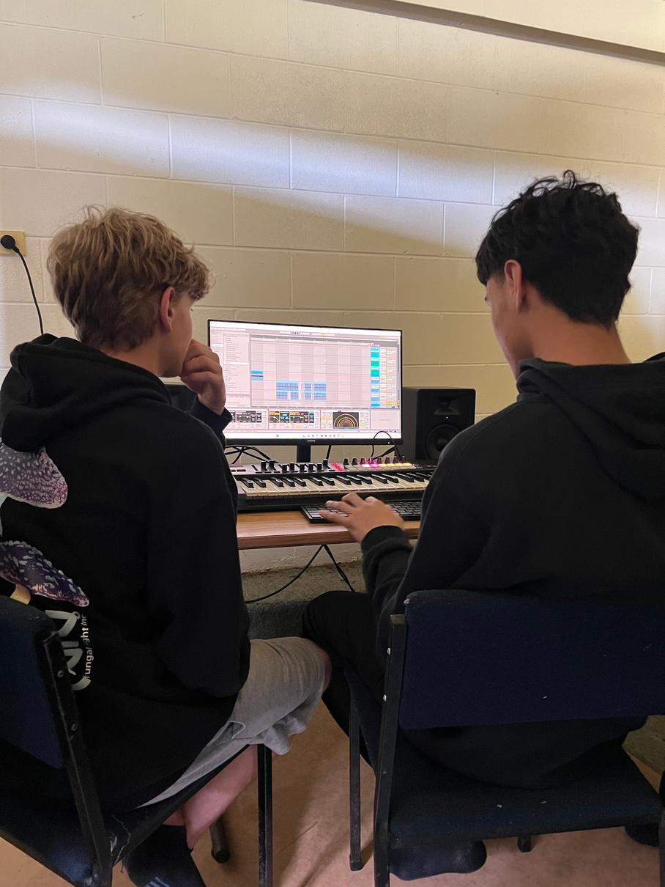
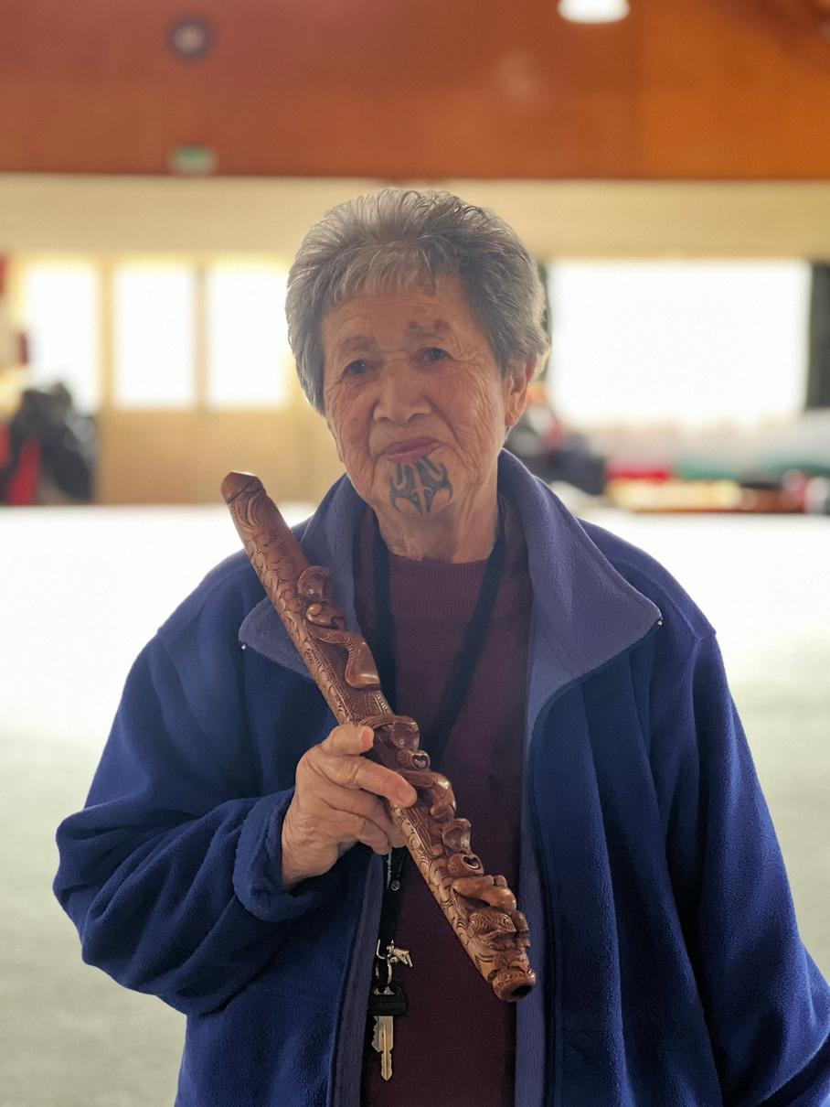
COLLABORATION
He rangai maomao ka taka ki tua o Nukutaurua, e kore a muri e hokia.
When a shoal of maomao fish has passed seaward of Nukutaurua rock it will never return.
MANAKITANGA
PAINGA
MAHITAHI
AROHA

Slide 12

VISIONING
What is your vision for what success looks like?
What is your vision for your environment?
What does learning and assessment look like?
W
Why
W
What
Why do we do what we do?
Why are we here?
What can you see your students learning/doing?
What are you doing?
What are your barriers?
W
H
Where
How
Where do we see ourselves in the future?
Where is your perfect teaching environment?
How can we make this happen?
Who do you need at your table?

Slide 13
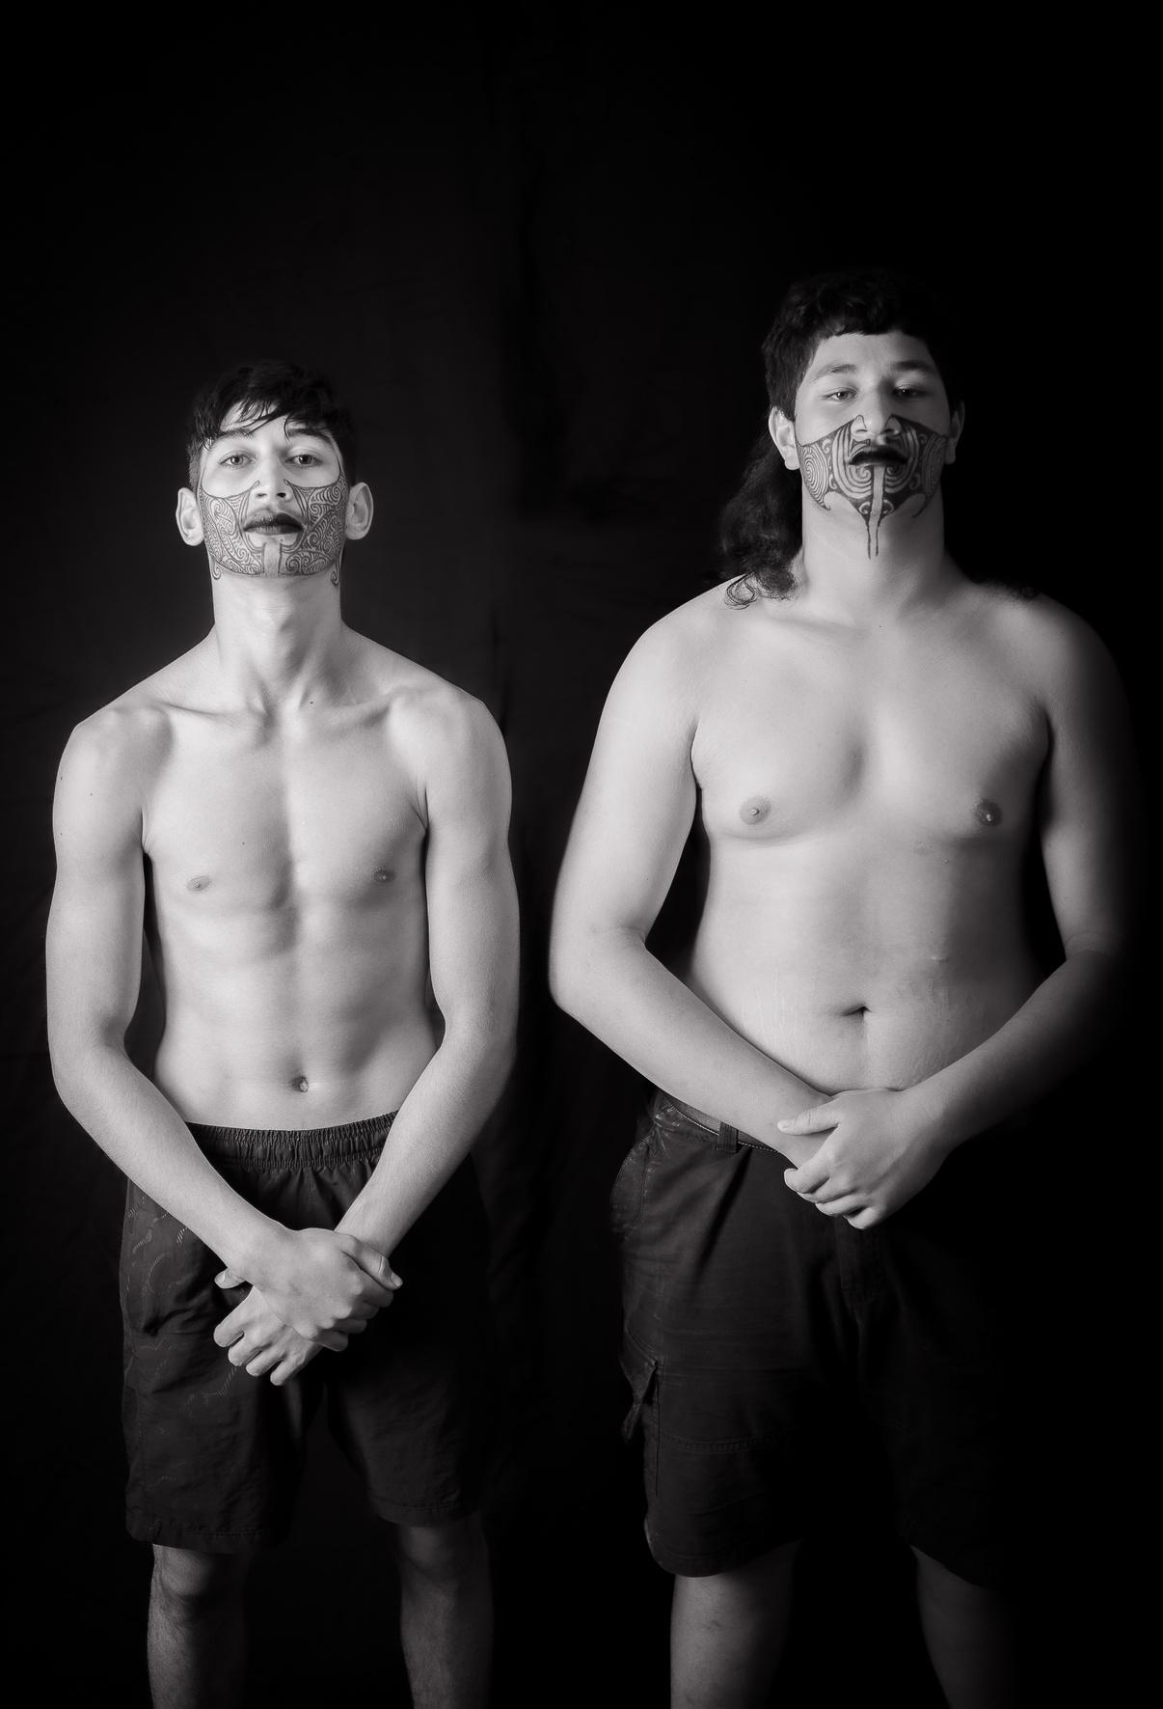
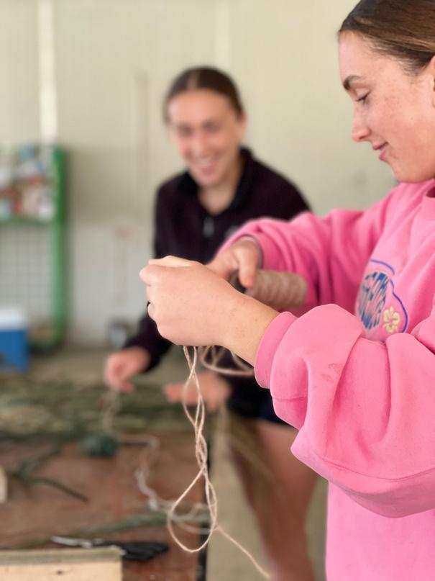
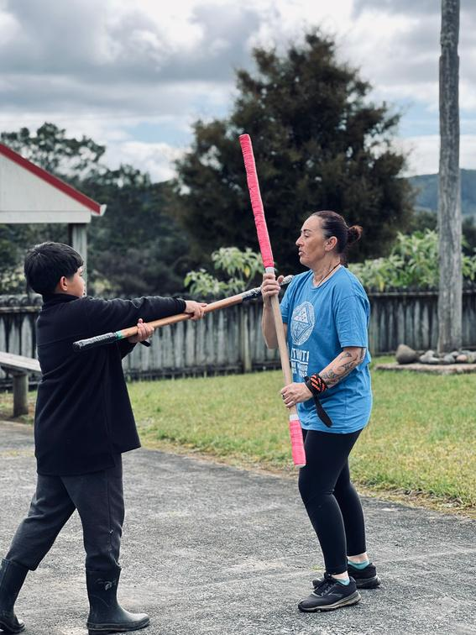
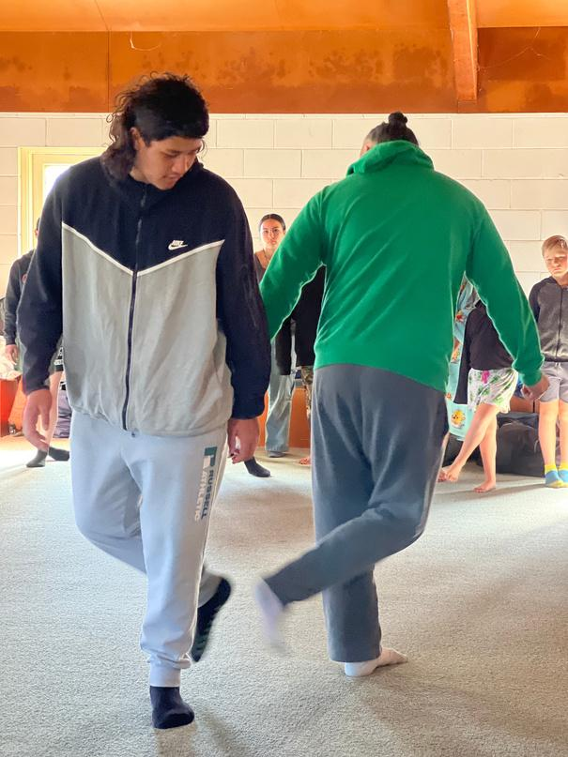
WĀNANGA
A means to break the barriers of the traditional education system.
Raranga
Mau Rākau
Tākaro
Make & Create
Learn
Practical tools to develop skills, games that tell stories and create competition.

Slide 14
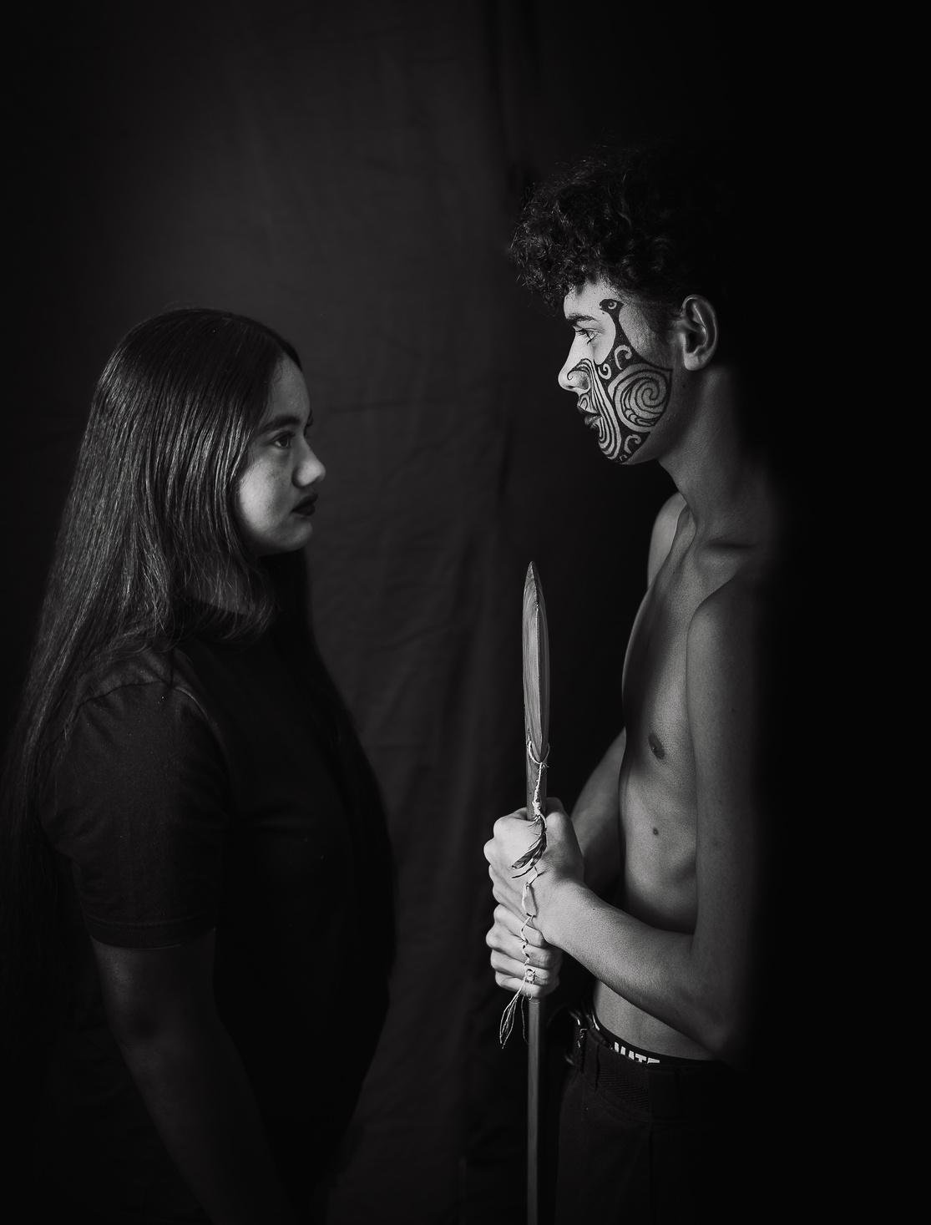

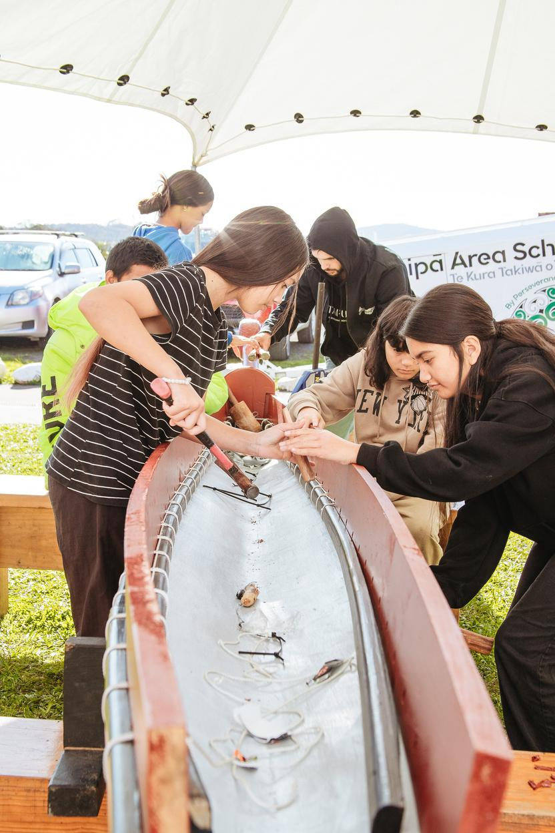
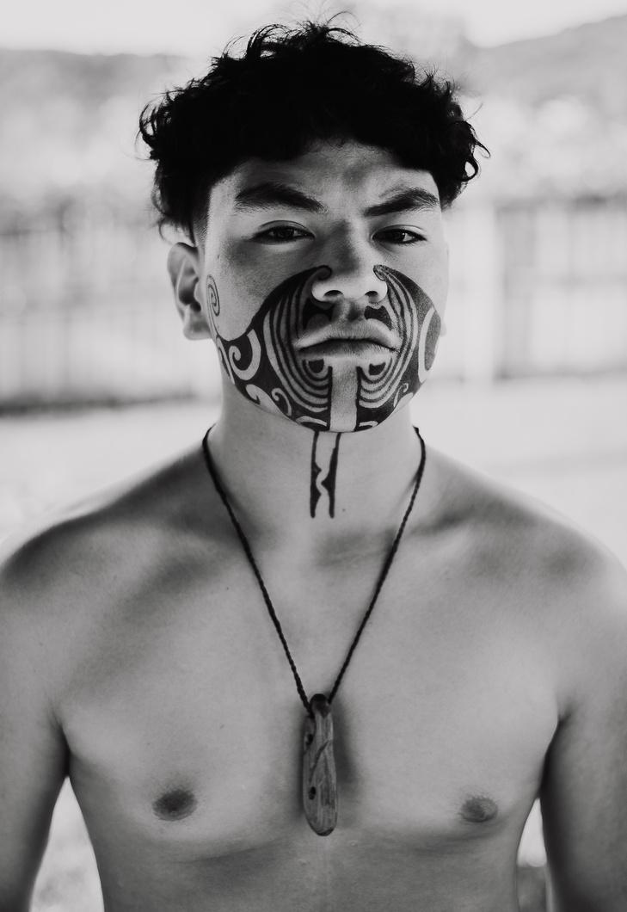
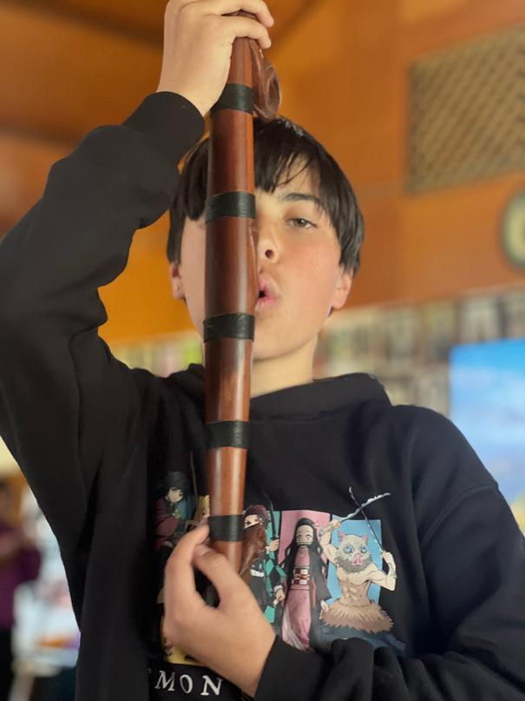
WĀNANGA
A means to break the barriers of the traditional education system.
Waka
Kapa
Pūoro
Transport, tikanga, stories, belonging
Self-Esteem
Sound of Rongoa, connection, peace and hauora

Slide 15
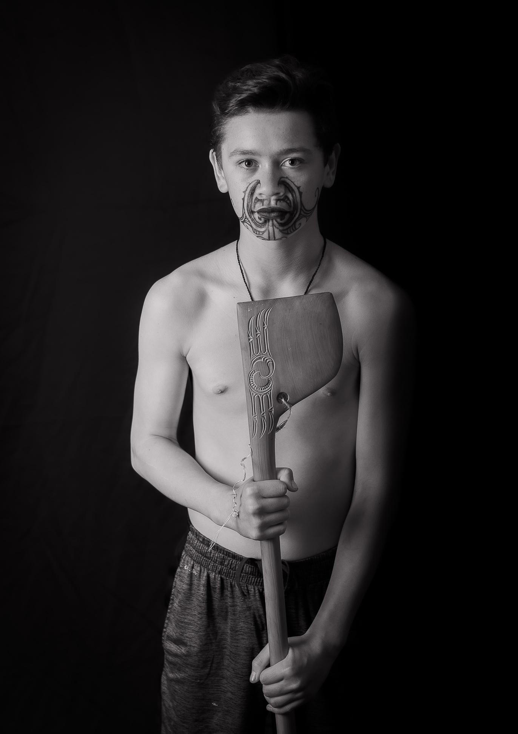
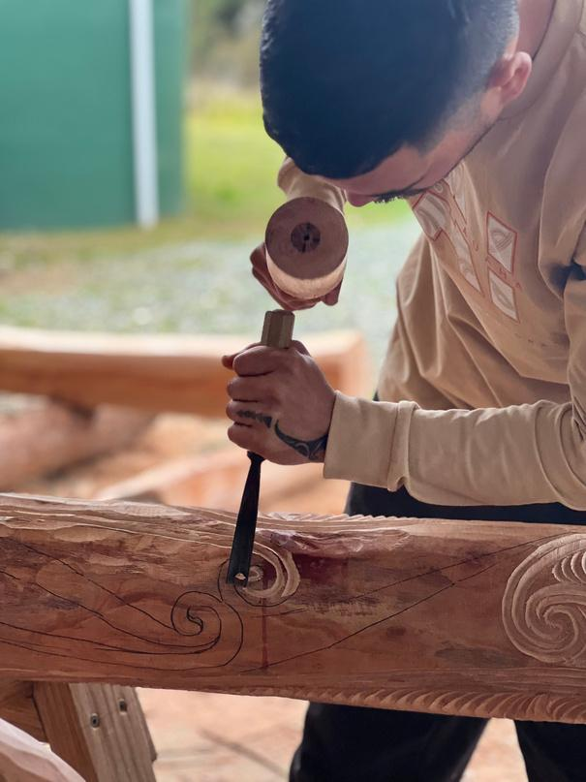
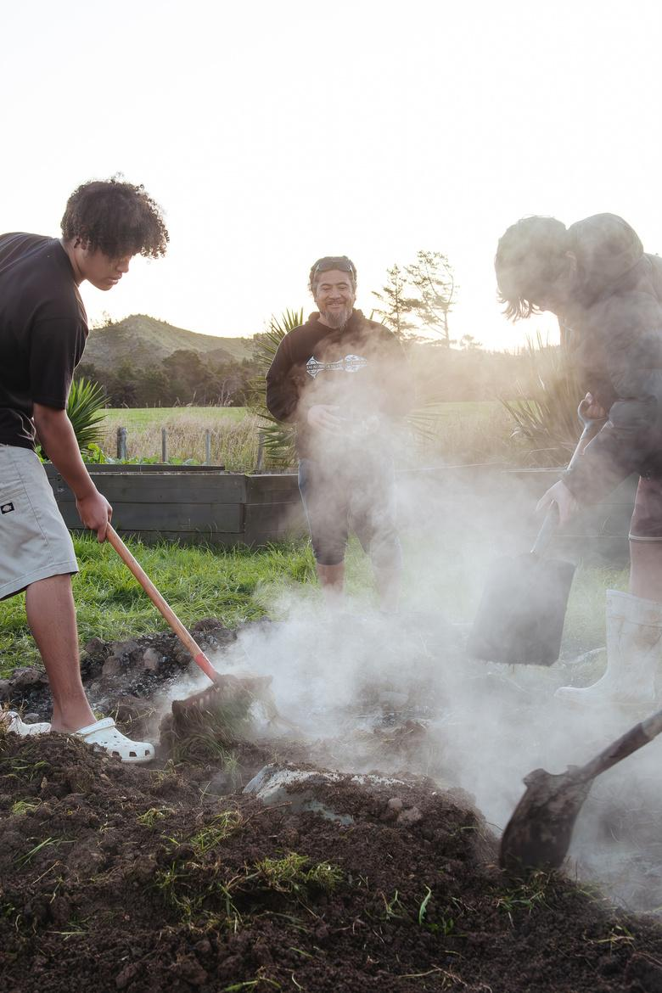
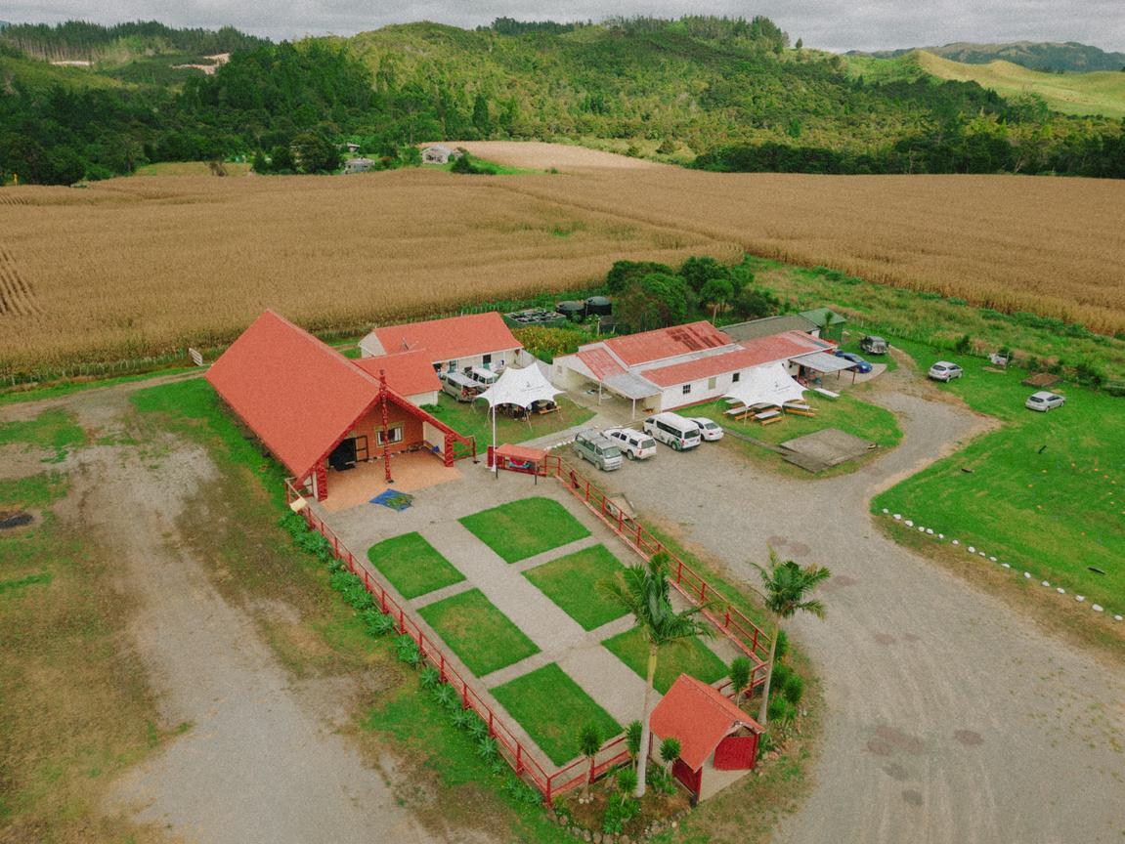
WĀNANGA
A means to break the barriers of the traditional education system.
Whakāirio
Hāngi
Pūrākau
Mold, Shape
Skills of effective whanaungatanga
Learn the stories of the whenua,
of the Moana, of the Ngahere, of the people.

Slide 16
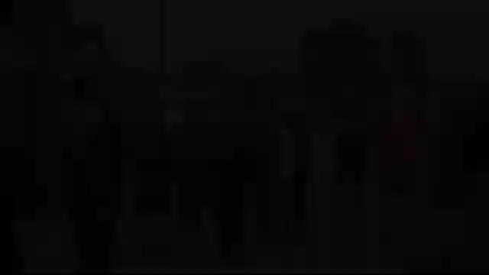


Slide 17

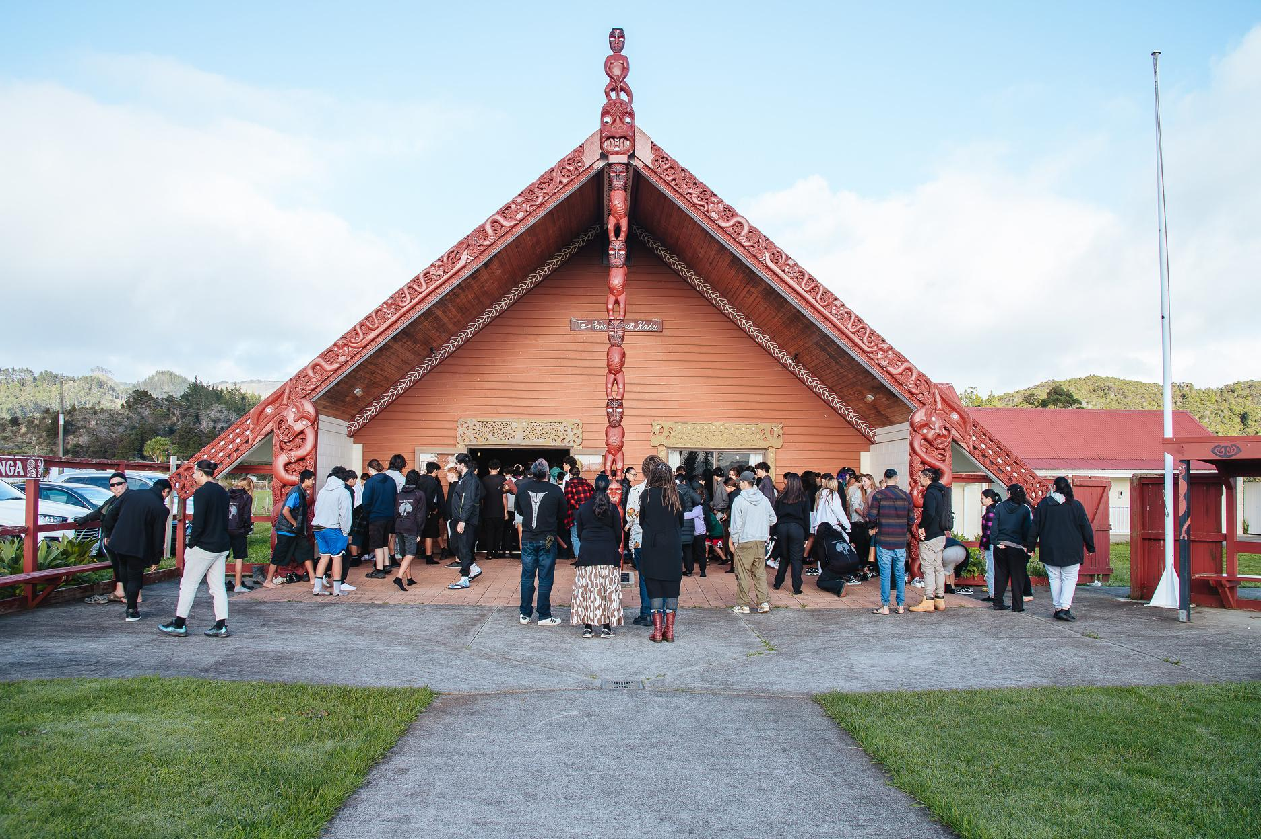
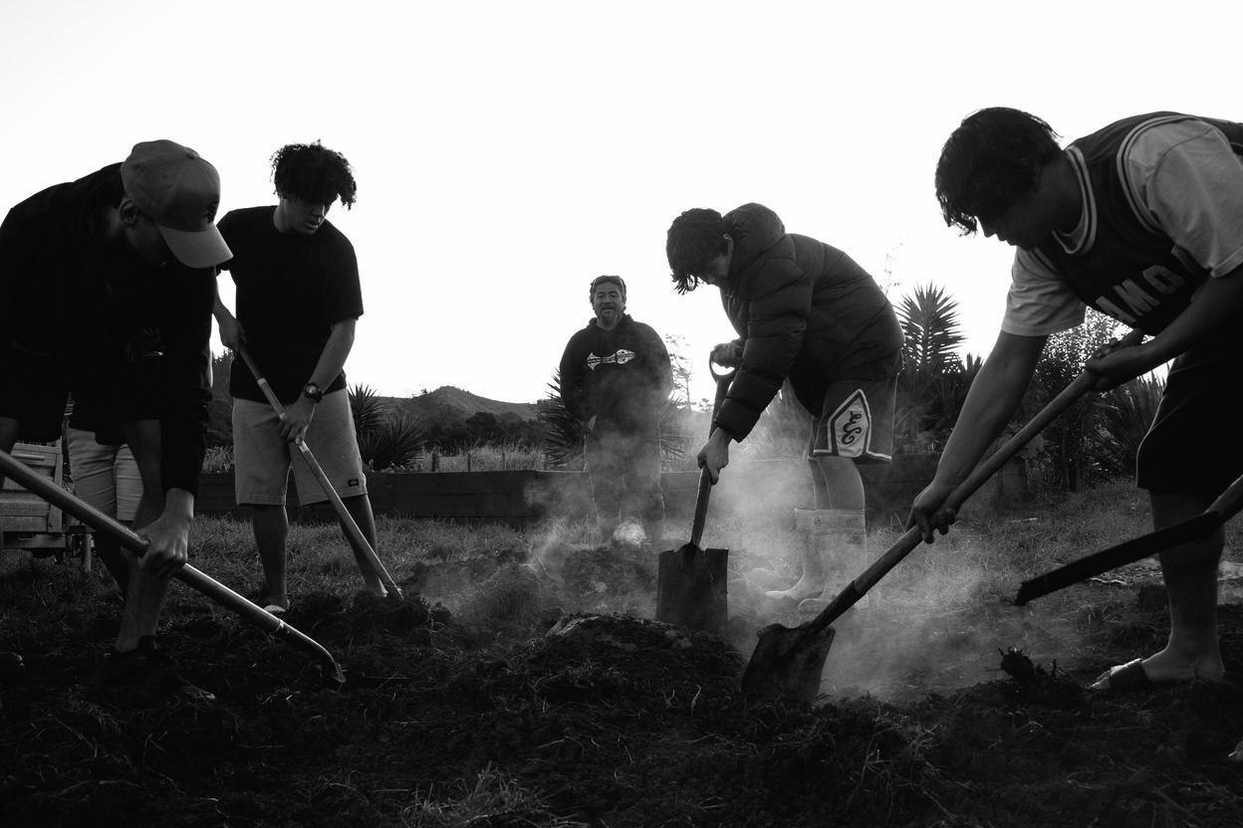
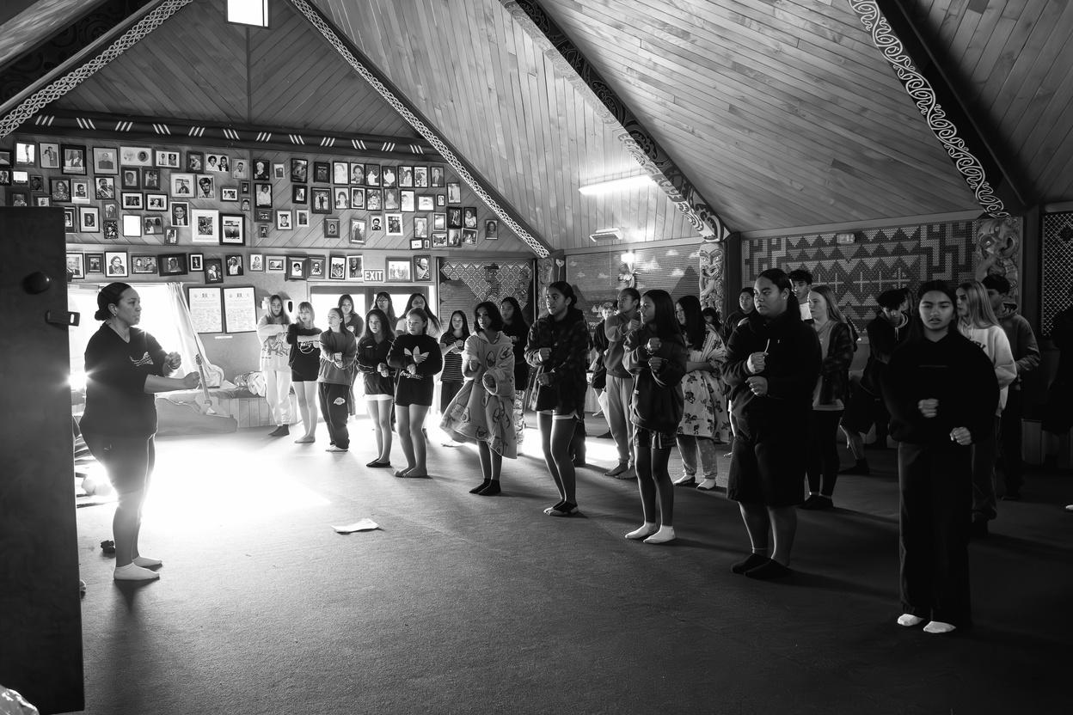
TE KAUHANGA
MARAE
What other subject areas can you collaborate with?
What are your values?
How do you connect?
What are you capable of?
What are your limits?
Where do you see yourself?

Slide 18

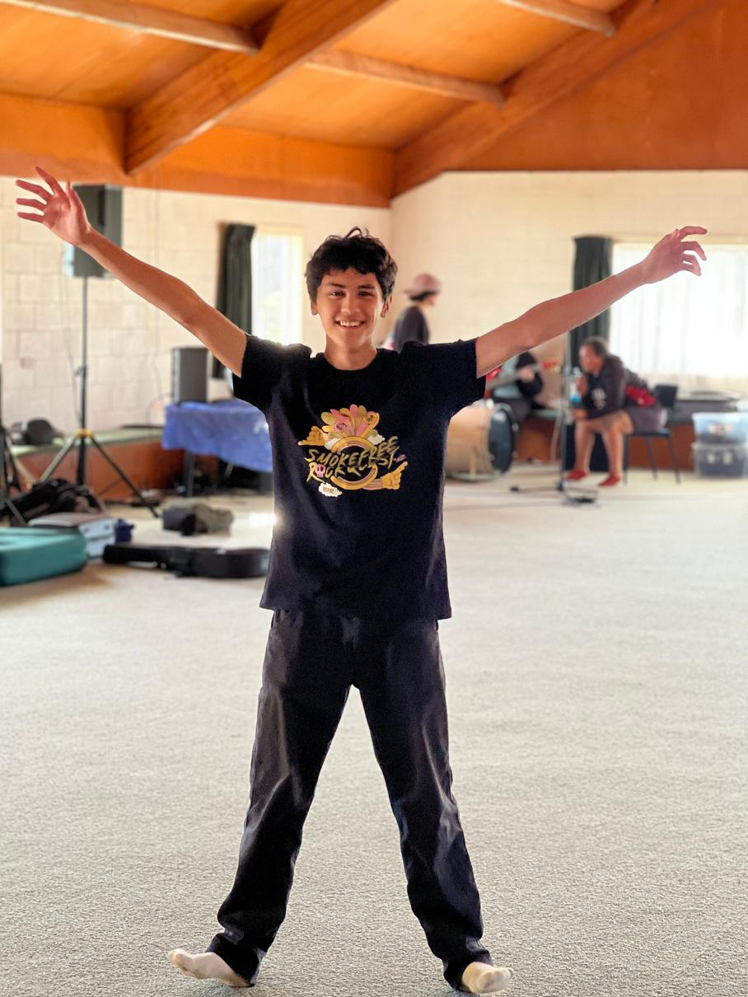
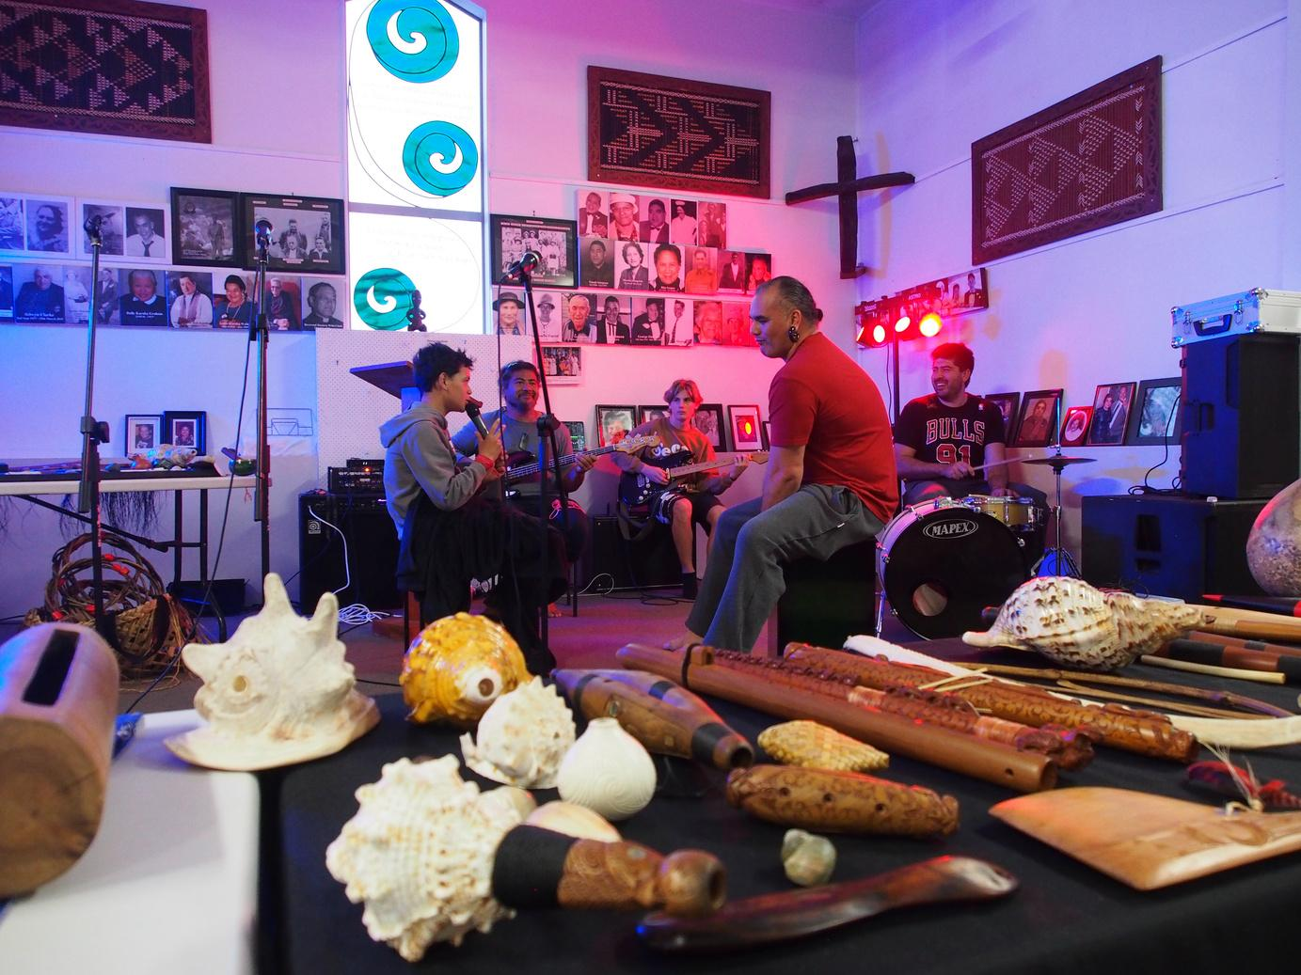
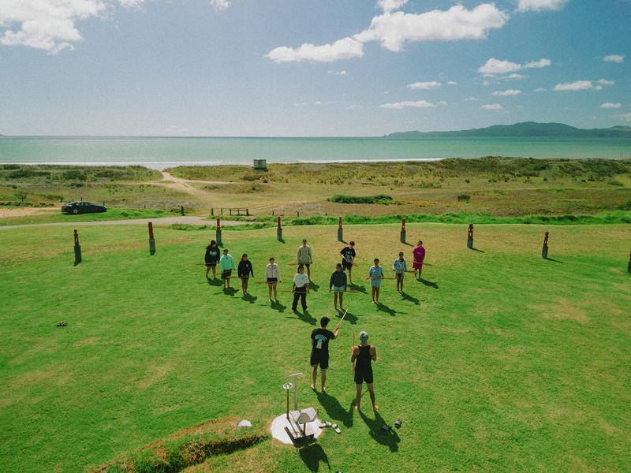
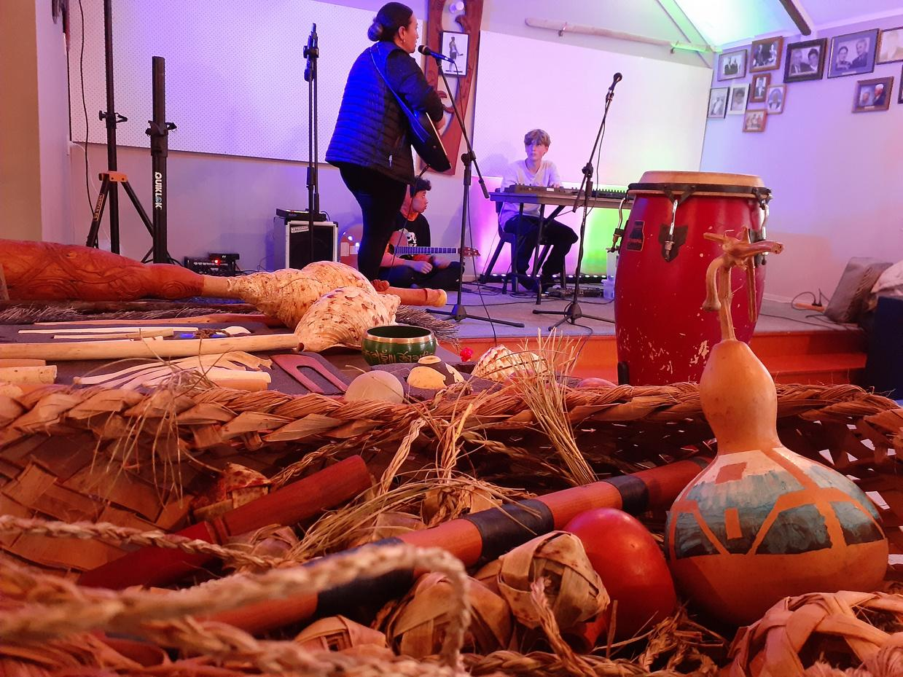

KEY MOMENTS
Development of success and accelerated learning through strategic Taonga Pūoro wānanga.
Our Wānanga are all based in Ngāti Kahu to build the strong partnership.
TANGATA BEATS
TAONGA PŪORO
WAKA KAUPAPA
TAONGA PŪORO
Wānanga a Kenana
Wānanga a Te Paatu
Wānanga a Aurere
Wānanga a Haititaimarangai

Slide 19


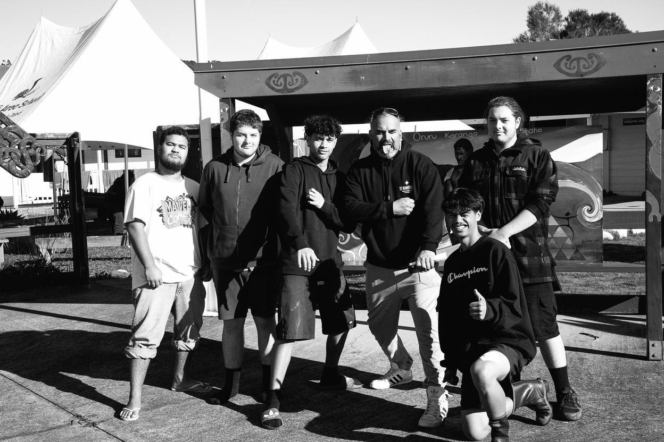
SUMMARY
1
Use the environment, the stories, the land shapes, the sounds, the people.
CONNECTION
2
Use other subject resources to help each other.
COLLABORATION
3
This will be the hardest yet rewarding time of your teaching career - if done right. Utilise your resources
There is no one way to do things - every kaupapa is different - you need enough tools in the kete to be flexible when needed.
WĀNANGA
4
Once you build the bridge it’ll be there forever - how? with manaakitanga, listen more than speaking, share your heart, spend time - face-to-face.
RESOURCES
'Iti noa ana, he pito mata'
From the withered tree, a flower blooms.

Slide 20


Slide 21
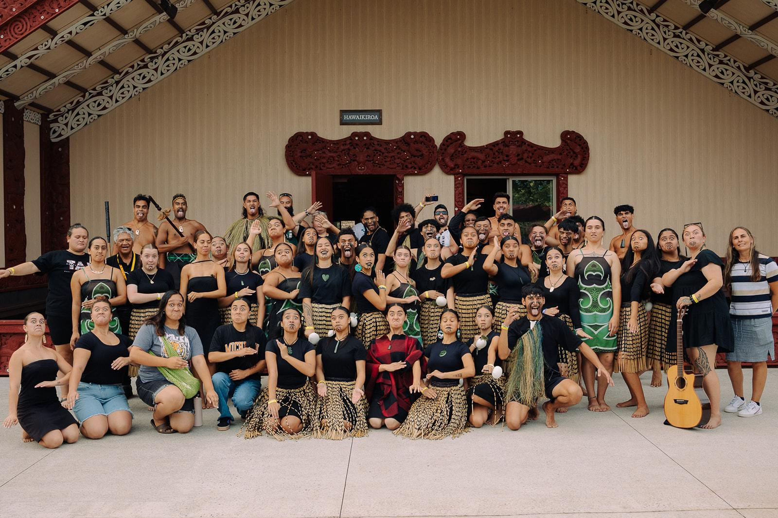
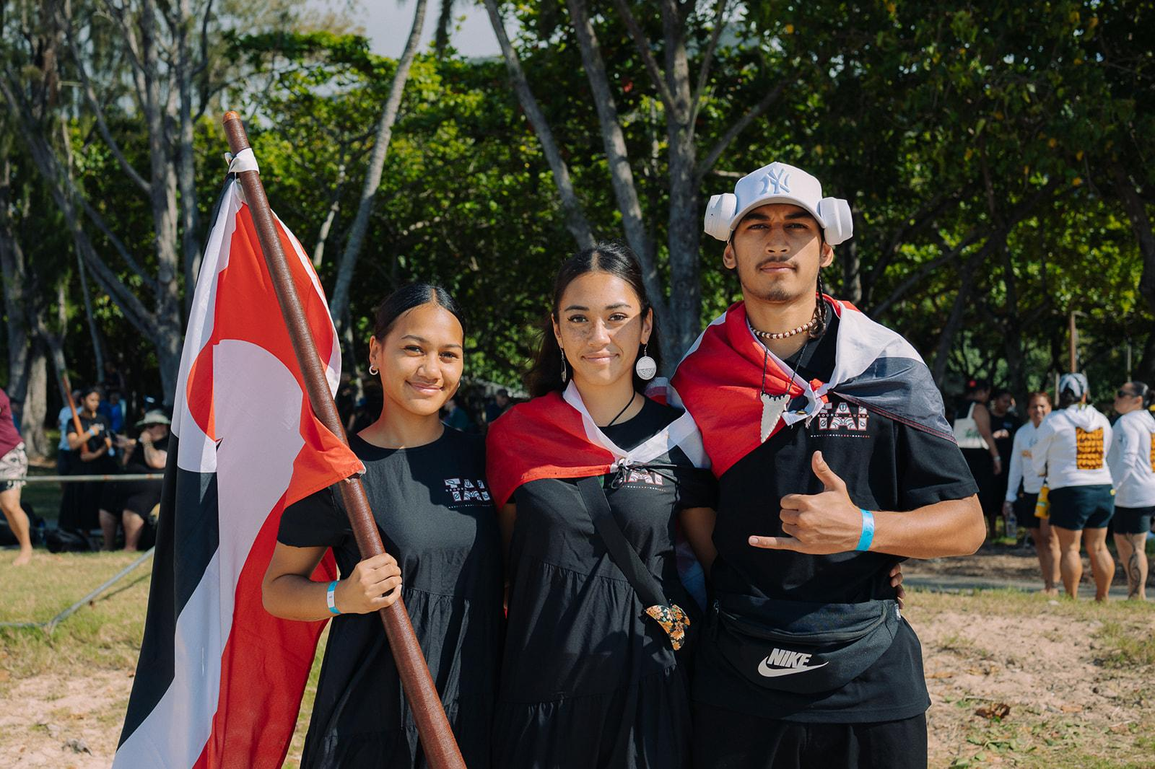
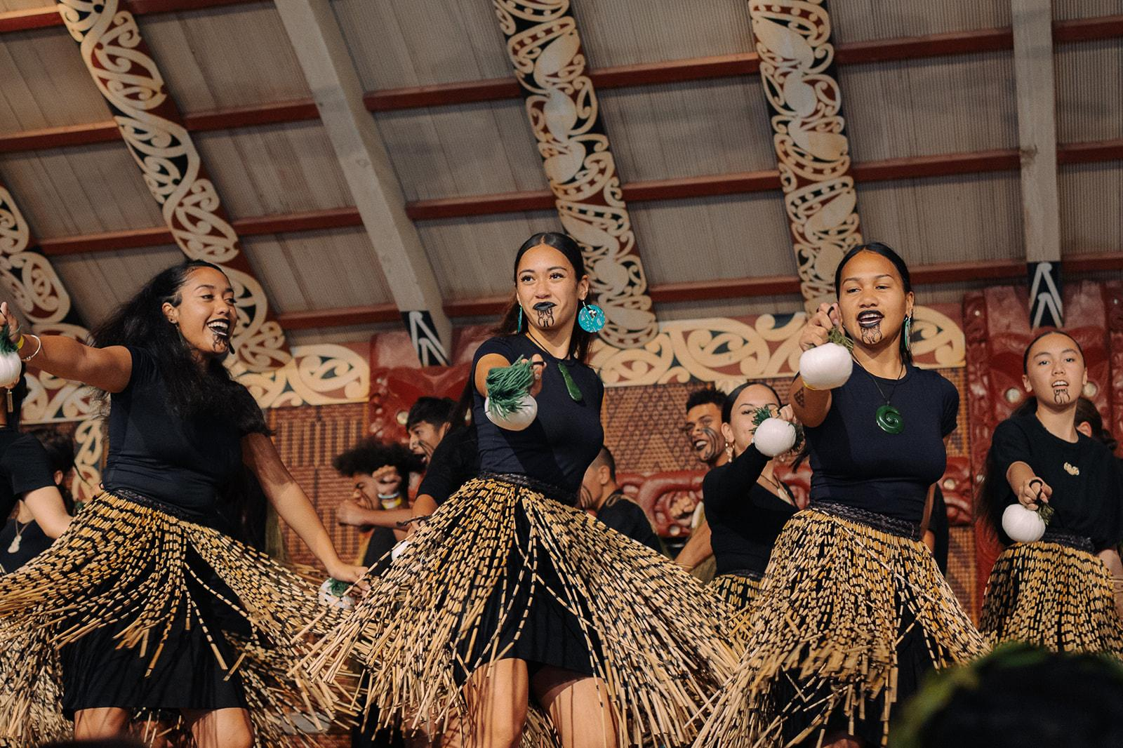
FestPAC 2024 - Hawaii
A means to break the barriers of the traditional education system.
Festival of Pacific Arts & Culture
Auaha
Orooro
Creative
Vibration

Slide 22
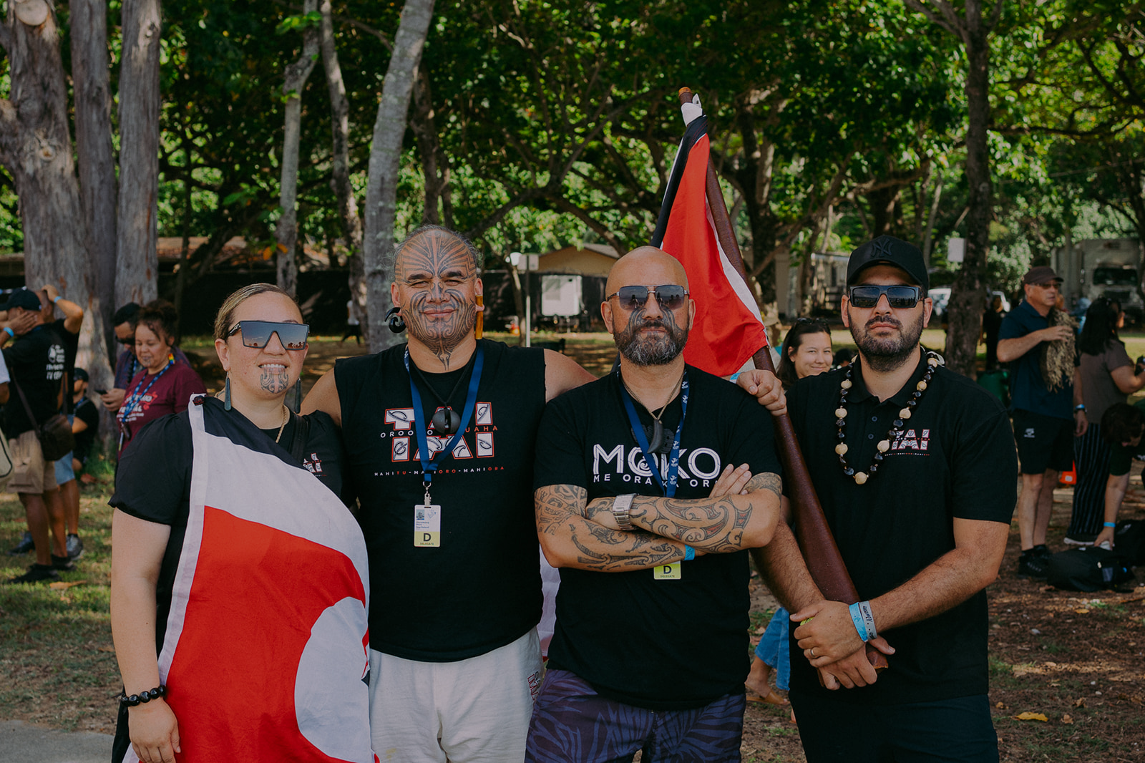

Slide 23

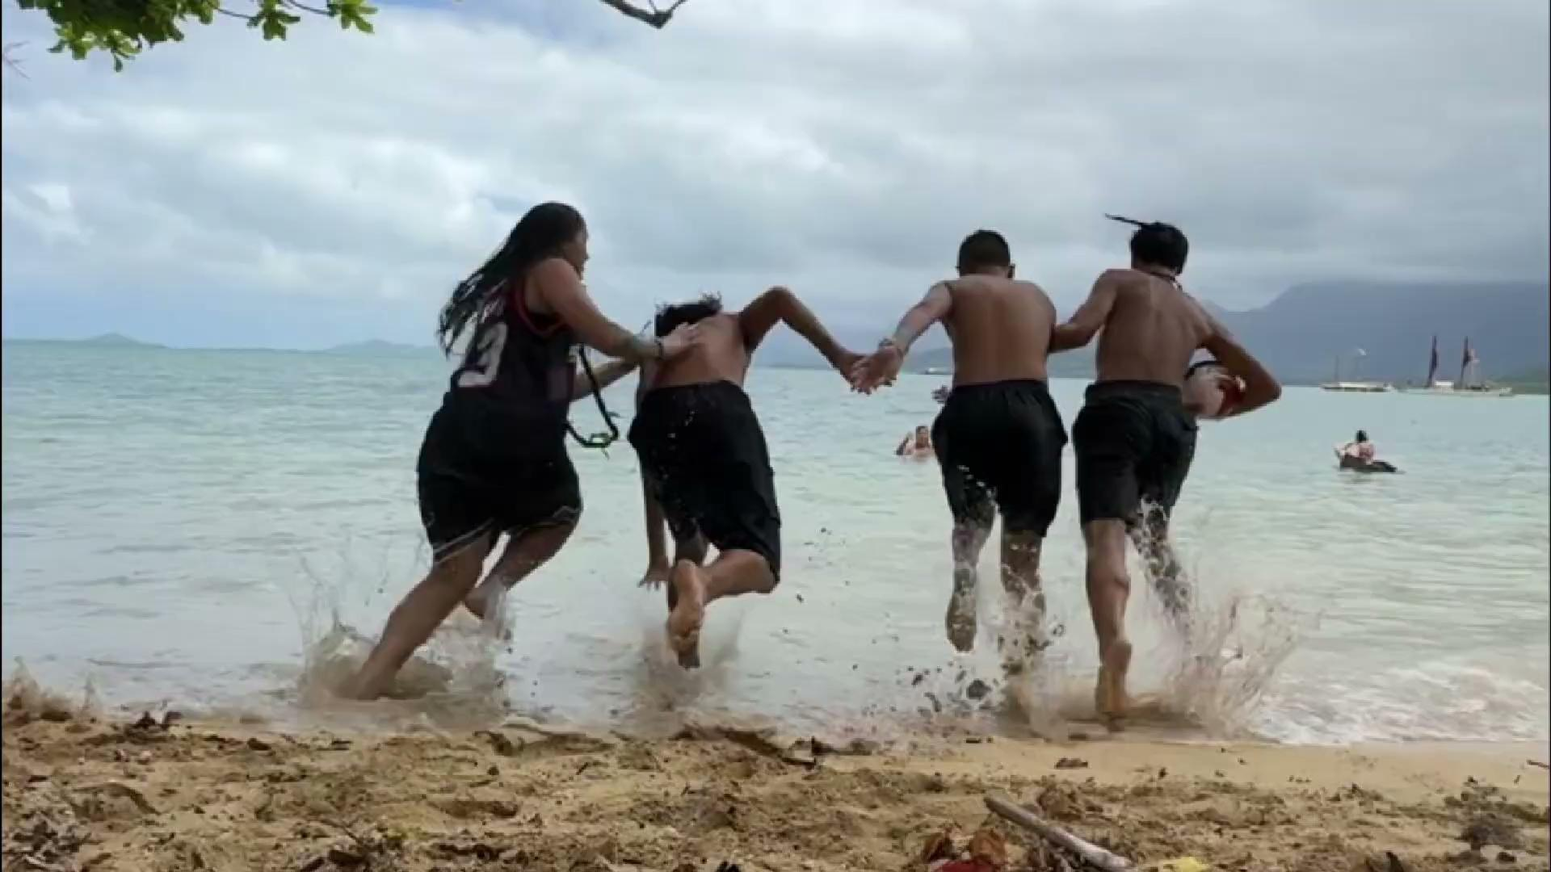

Slide 24
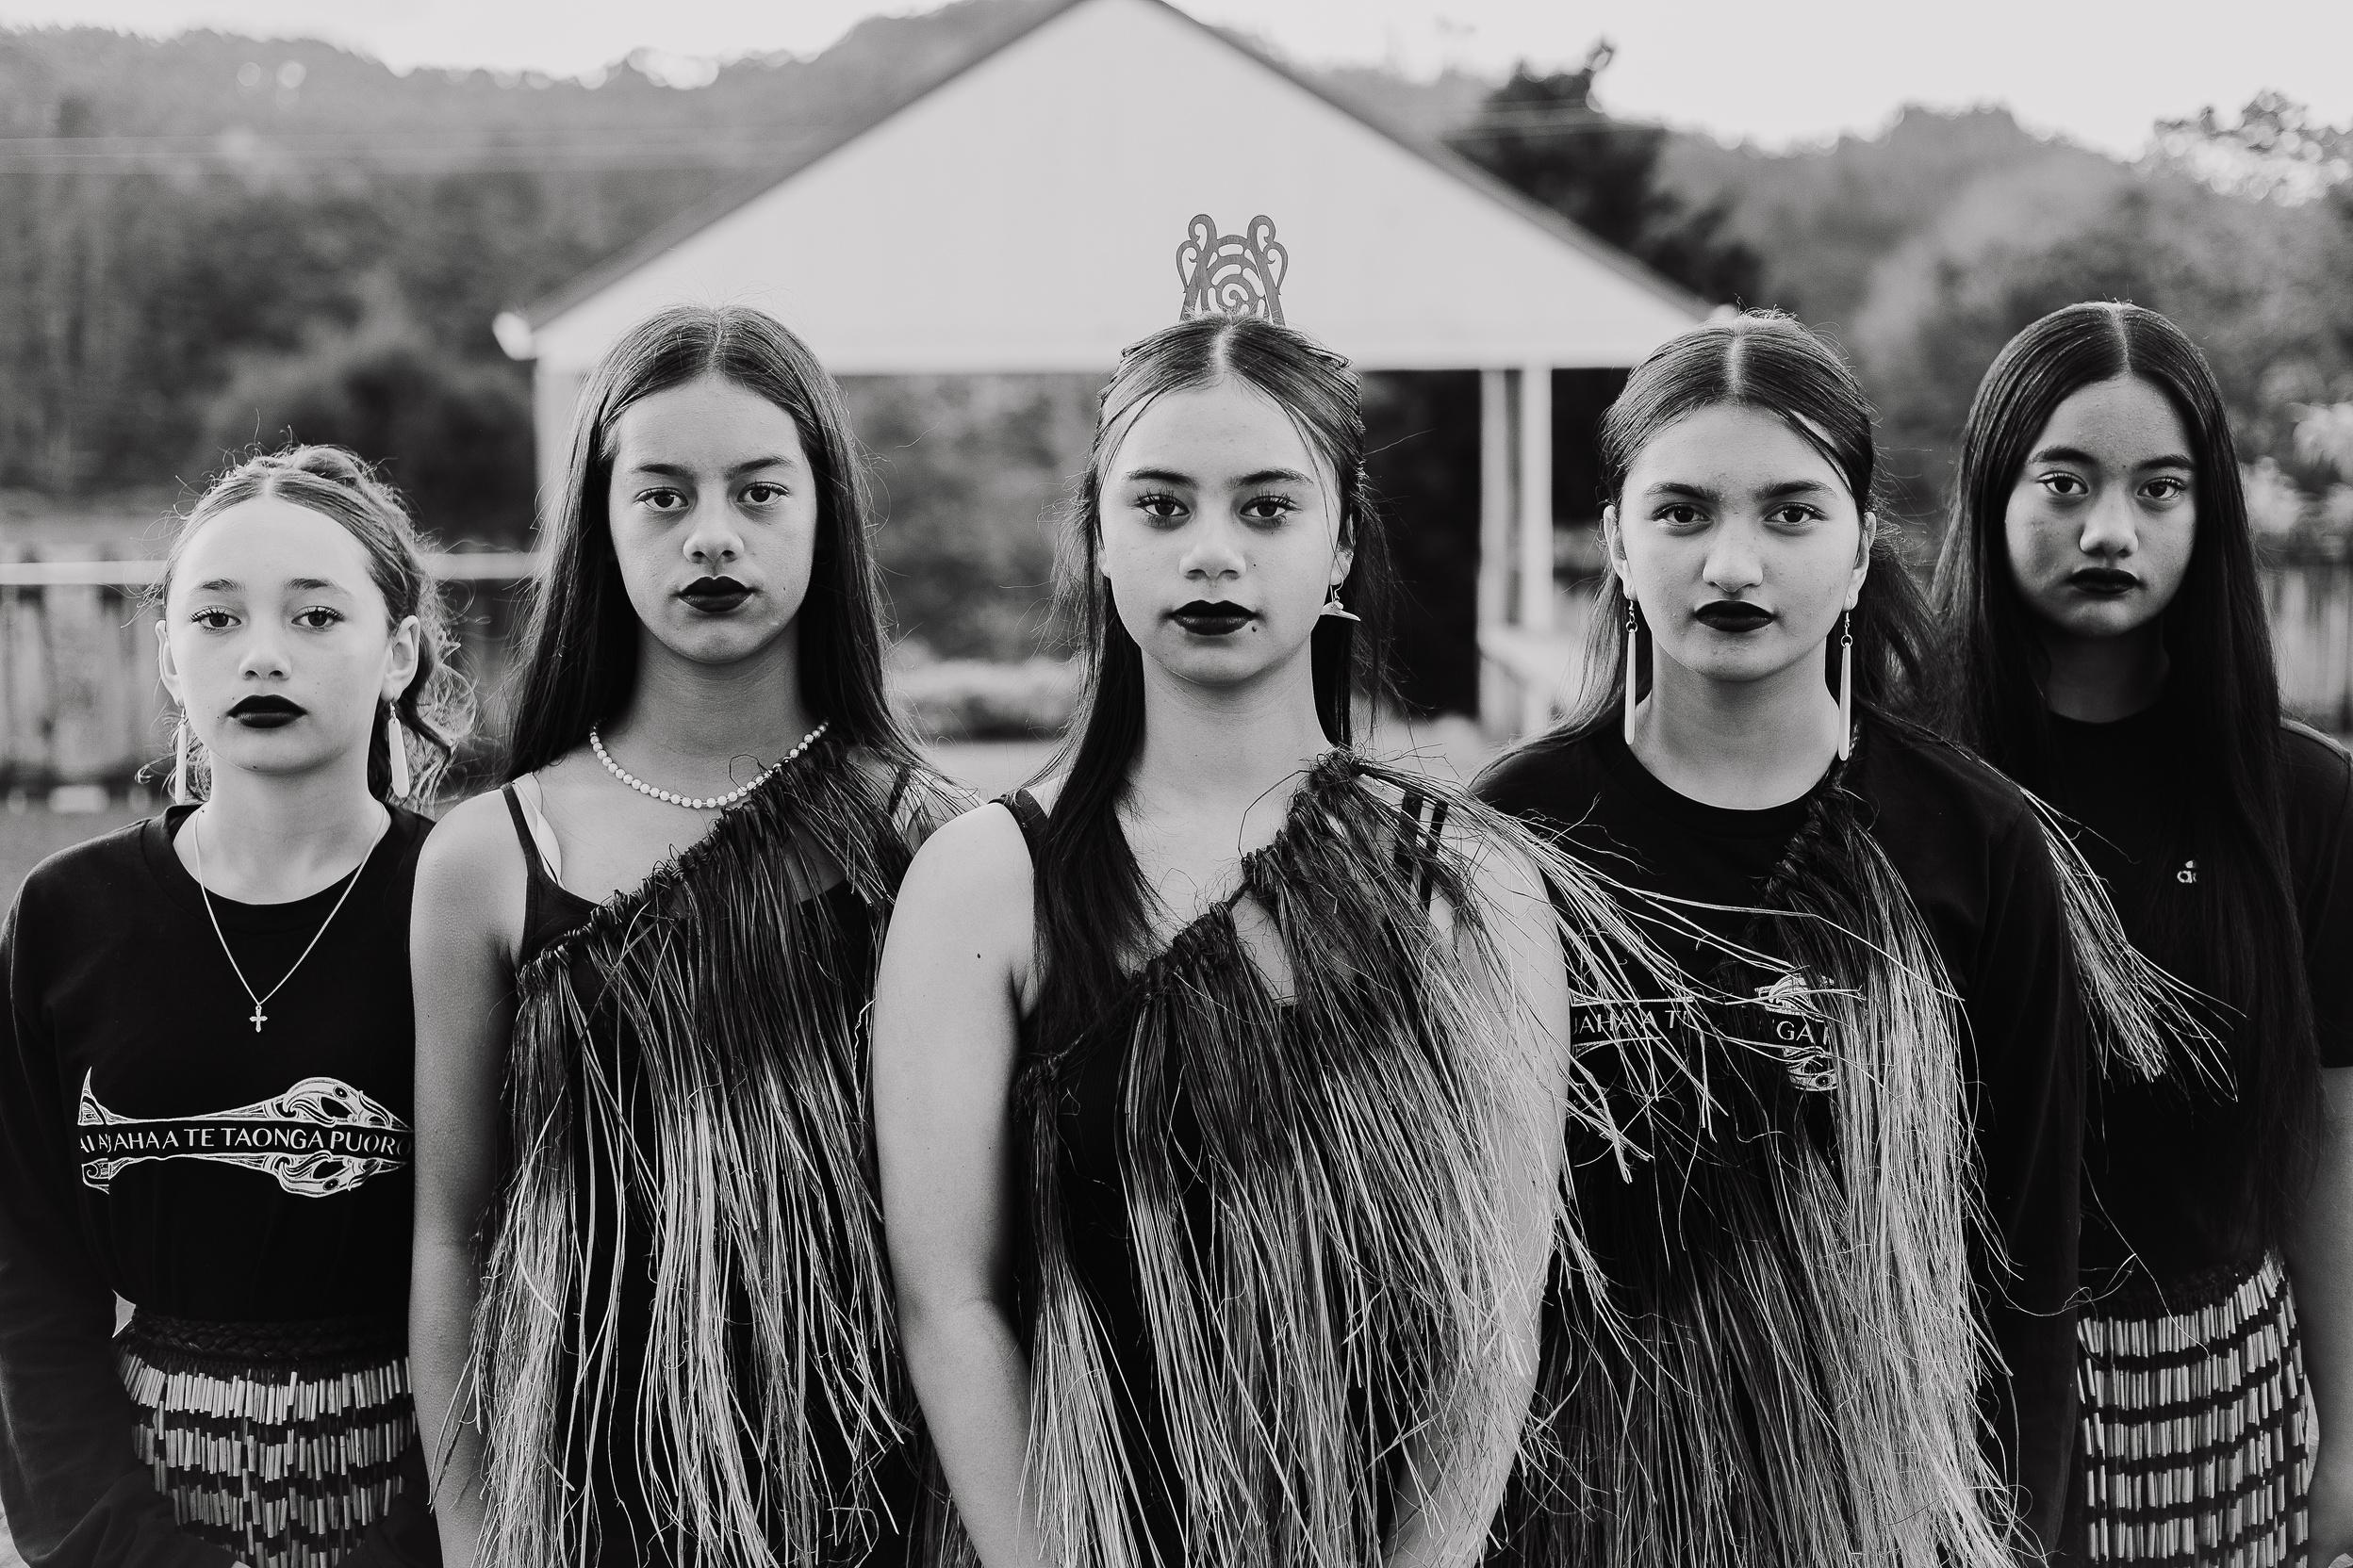
NGĀ MIHI MAIOHA
I

Slide 25
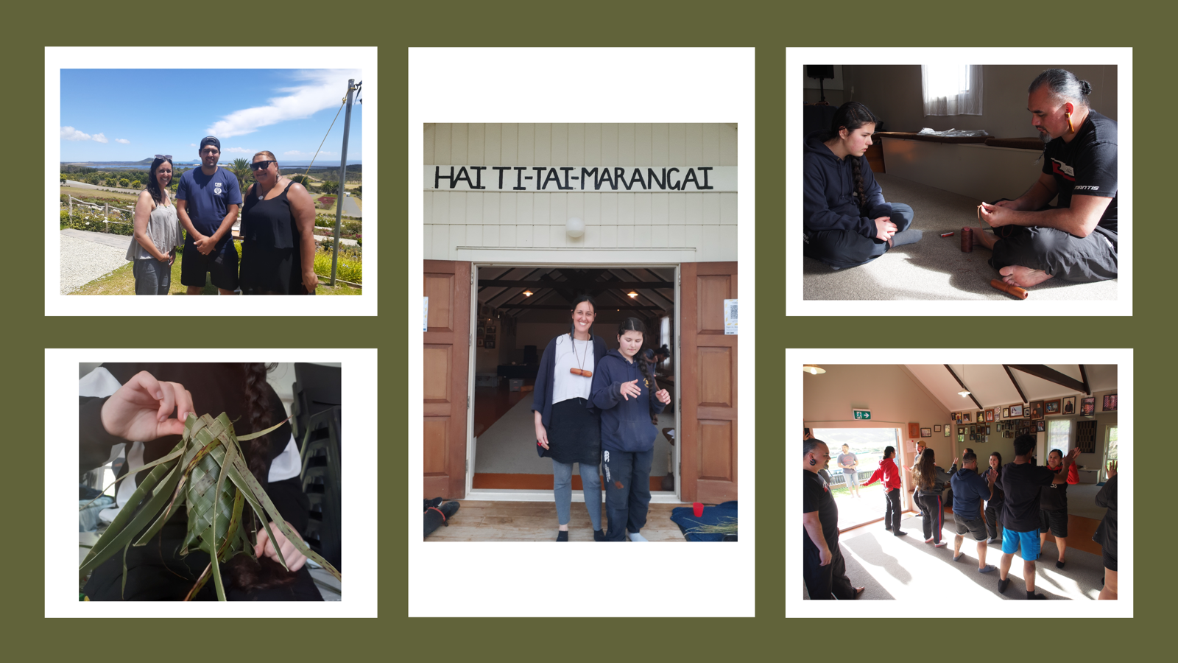

Slide 27
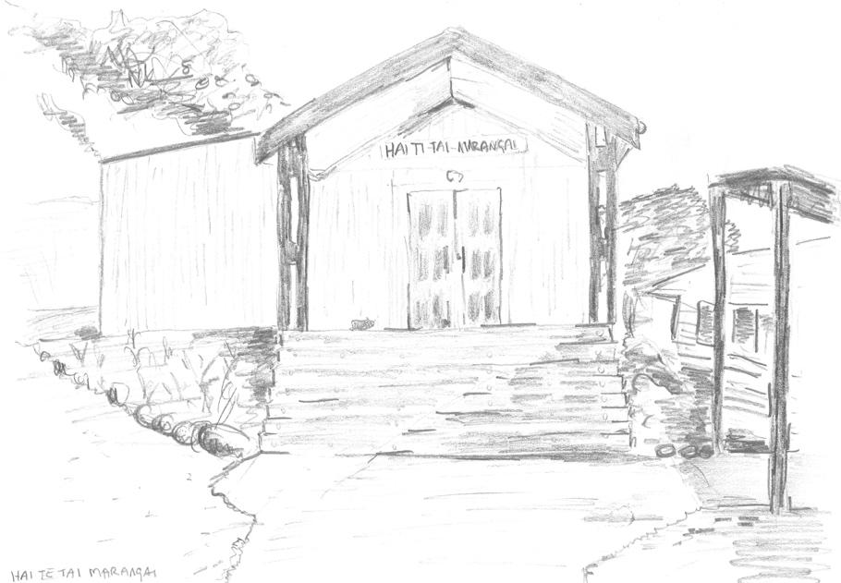
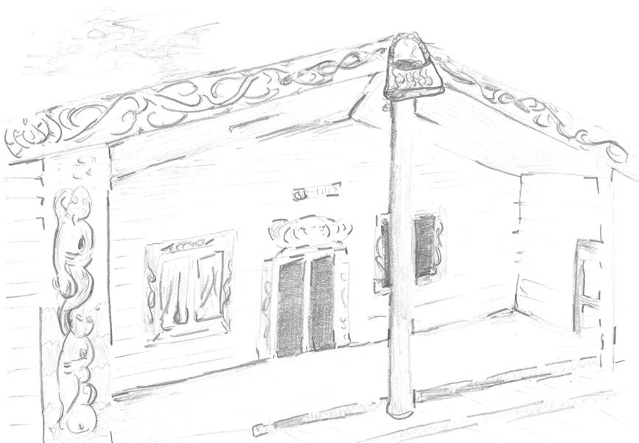


Whatuwhiwhi Marae (Haiti-tai-Marangai): August 2-5th 2021; June 27-30th 2022
Te Paatu Marae (Piri ki Te Paatu): 19 - 23rd September 2022
Kauhanga Marae (Te Poho o Ngāti Kahu) ]: June 12-16th 2023
Kenana Marae (Te Ranginui): May 13-17th 2024

Slide 28

a/r/tography
artist-researcher-teacher
•Interviews + focus group work
•A/r/tographic inquiry: Both focus groups in collaboration during wānanga

Slide 29

Two Focus Groups
Focus Group One: Ngā toi Māori expertise including ngā mahi a te rēhia, taonga puoro, and taonga tākaro | Tai Orooro Tai Auaha and Ngāti Kurī Creatives in Schools Project with Rawiri Hindle.
Focus Group Two: Mainstream arts education expertise, across music, dance, drama, and visual arts learning areas, particularly those with expertise in creative learning processes and play-based pedagogies.

Slide 30
“Pou help to create space between the earth and the sky, and we can live in that space, and play in that space…around that pou things radiate and around a person things radiate”
Jacob Scott, son of Māori architect John Scott, speaking about his father’s work

Slide 31


Tūtahi Tonu Te Aka Matua ki te Pou Hawaiki January 2023
Tūtahi Tonu Ngā Tauira Marae
September 2024

Slide 32

There is an invitation to undertake a deep inquiry through our relationships as non-indigenous academics to support the creation of new approaches in education that “connects the vehicles of the mind, spirit, and people.”
Honourble Tā Joe Williams (2020)

Slide 33


